Slide 1

Professional support guides
Presentation 1

Slide 2
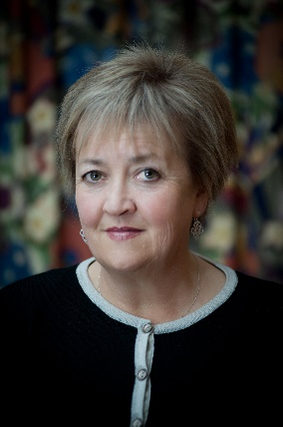
Welcome
To the College of Nurses (NZ) Inc
Professor Jenny Carryer, Executive Director
Welcome to our professional support guides
This is a series of 4 presentations
Designed for you, our College members
To view at your own pace whenever you want to and wherever you are.
They contain;
Useful information, advice and guidance
Links and references

Slide 3




The Support guides
4 Presentations
1. About us
2. Portfolios
3. Bullying
4. Practice issues
Who we are
College purpose
Membership options
Benefits/ Indemnity
Why we do portfolios
How to create a portfolio
Hard copy
Electronic
Bullying defined
Recognising bullying
Reporting bullying
Managing a bullying situation
Employer: How to manage performance improvement or disciplinary processes
Employee: How to engage successfully in a performance improvement process
Dealing with a disciplinary process

Slide 4

About us
Presentation 1
Who we are
College purpose
Membership options
Benefits/ Indemnity

Slide 5

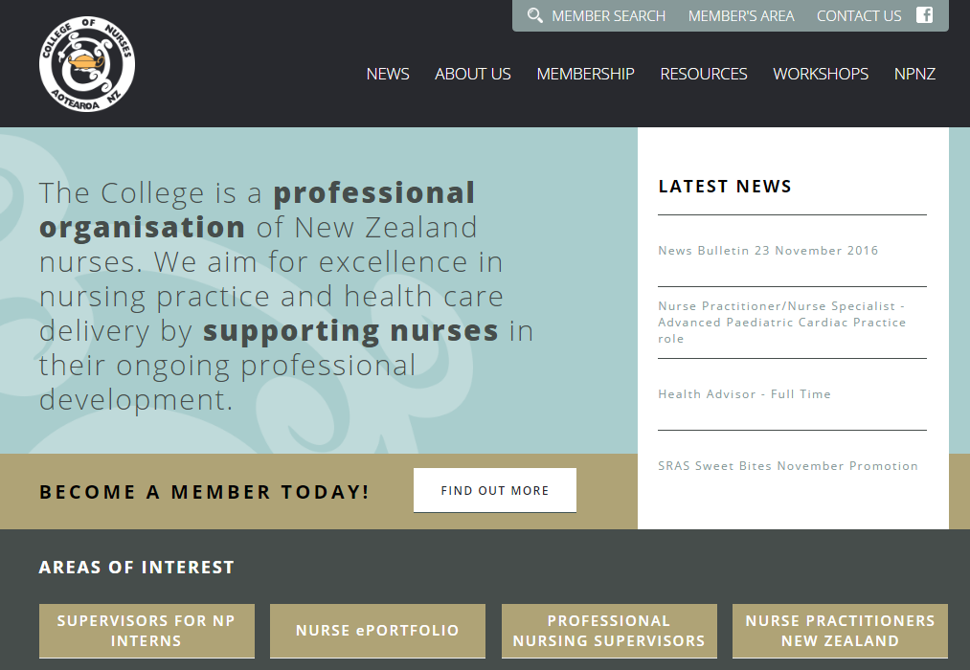



The College of Nurses (NZ) Inc
Who we are….
We are
A professional association of New Zealand Nurses from all regions and specialties
We aim
To achieve 100% access and zero disparities in health for all New Zealanders with a focus on professional nursing issues
We provide
Indemnity insurance, a wide variety of resources, workshops, publications and networking.

Slide 6
Our Purpose, Vision and Strategy
The College of Nurses (NZ) Inc.
Purpose
Vision
To provide a forum for critical inquiry into professional, education and research issues relating to nurses and to the achievement of equitable outcomes for health consumers.
Professional excellence in nursing practice and health care delivery through: innovative health service delivery and the development of models of care with the aim of creating 100% access and zero Disparities.
Align workforce development with community need
Influence health policy
Providing leadership, critical advocacy and contribution to national health and socio-economic policy.
Competent and effective registered nurses and nurse practitioners working within models of care that make the best use of the full extent of their education and training
A sustainable future for the College
The College continues to utilise its strength and maximise its growth through effective use of resources

Slide 7



Membership options
Professional Presentation
Open to all Registered Nurses and Nurse Practitioners
RN or NP; min 5 years experience. Able to demonstrate exceptional contribution to nursing.
Member
Fellow
Employed under 20 hrs/wk or in full time study
Part time/ studying
Retired
Retired from nursing but wanting to keep in touch.
Dual
For more information
visit the website
www.nurse.org.nz
If you are already in another professional or industrial body

Slide 8








Benefits of being a college member
A few examples…..
Resources
Treaty partnership
The College provides regular members updates, access to online resources, journals, consultations, professional development opportunities, scholarships, nursing vacancies and news on current nursing related issues.
The College acknowledges Te Tiriti o Waitangi as the foundation document of this nation and this underpins all activities undertaken by the College, including structure and governance.
Workshops
The College is responsive to membership needs and runs regular workshops on a variety of topics.
Indemnity
Which covers legal costs and expenses if you are alleged to have provided inadequate advice, services
Mentoring, coaching and supervision
The College provides access to professional nursing supervisors who can be directly accessed by the College membership.

Slide 9
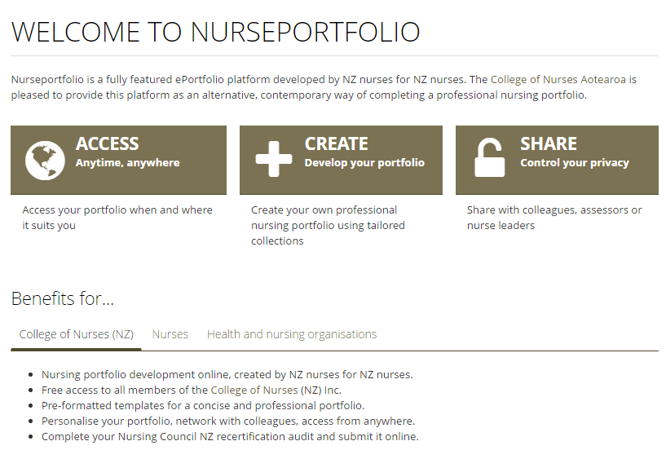


Web resources
More examples of College resources available on the website…
Nurse ePortfolio
Professional Supervision
Supervisors for NP Candidates
Free to College members.
Try a new way of presenting evidence of your practice competence
Add your professional supervisor profile or access a professional supervisor.
Videos, links, tips and resources to support you in your role as a supervisor for NP candidates.

Slide 10



Reading resources
Even more….
Praxis
NZ Nursing Review
Te Puawai
Easy access to New Zealand's journal of professional nursing
Keep up to date with a copy of Nursing Review, delivered to your door
The College journal with article, conference reports, research and resources

Slide 11
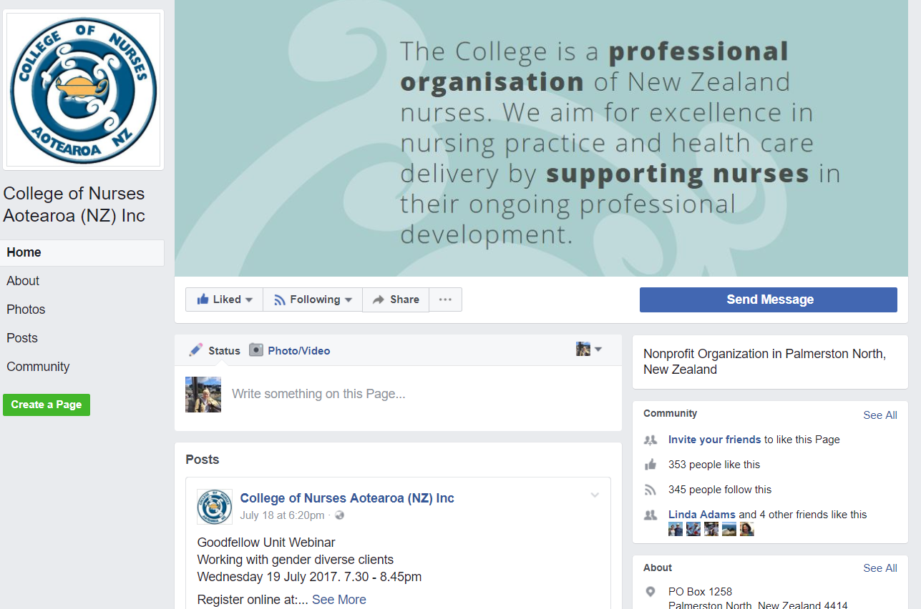


FaceBook & Goodfellow
Social media, emails and education online
Keeping up to date
Like us on
Or
Login to The Goodfellow Unit for updates, podcasts, YouTube clips
Email updates delivered to you each day with job vacancies, news, national consultations, scholarships and education

Slide 12

College endorsements
Quality measure and PD hours allocation
Journal articles
Workshops and training
Online learning
Conferences

Slide 13
Professional Indemnity
An overview
What is indemnity?
Indemnity Insurance protects you against legal costs and any penalties incurred on Indemnity claims only. The College professional indemnity insurance provides individual and separate representation for each of our members, covering you 24hrs a day anywhere in NZ
What exactly does it cover me for?
Claims related to your professional practice:
Negligence claims or errors that may lead to injury, death or damage.
Disciplinary and competency proceedings eg. Nursing Council, Health & Disability Commissioner Investigations, Coroners Inquests
What if my employer has indemnity?
A major problem with indemnity insurance provided by an employer is the potential for conflict of interest. The issue for the employer is different from the issue for the nurse as both have different responsibilities and roles.
Where do I find more information about how to get help?
http://www.nurse.org.nz/indemnity-insurance-cover.html

Slide 14

Examples of indemnity claims
Here are some examples of when its been really important to have cover
Example 2
A civil case was brought against a nurse regarding the care given. The nurse required legal representation, Indemnity covered all the legal fees.
Example 1
Example 3
A complaint was brought against a nurse through the Health and Disability Commissioner regarding the quality of records kept. The nurse needed legal advice. Indemnity covered all the legal fees.
A nurse received a complaint through the Health and Disability Commissioner. After administering a vaccine that was not required.
Full legal support was received.
For more information
visit the website
www.nurse.org.nz

Slide 15

For more information…
http://www.nurse.org.nz/
admin@nurse.org.nz

Slide 16
The end
Check out our other professional support presentations
Portfolios
Bullying
Practice issues

