Slide 1

Professional support guides
Presentation 2

Slide 2




The Support guides
4 Presentations
1. About us
2. Portfolios
3. Bullying
4. Practice issues
Who we are
College purpose
Membership options
Benefits/ Indemnity
Why we do portfolios
How to create a portfolio for a NCNZ recertification audit
Hard copy
Electronic
Bullying defined
Recognising bullying
Reporting bullying
Managing a bullying situation
Employer: How to manage performance improvement or disciplinary processes
Employee: How to engage successfully in a performance improvement process
Dealing with a disciplinary process

Slide 3
Portfolios
Presentation 2
Why we do portfolios
How to create a portfolio for a NCNZ recertification audit
Hard copy
Electronic

Slide 4




Why we do portfolios
Lets get straight to the point…
Professional responsibility
Holds your evidence
It is the professional responsibility of all practising nurses to maintain their competence to practice, so you need a way to show that you do this….
A portfolio holds evidence of your current practice.
It is where you describe how you meet all the Nursing Council competencies for your scope and area of practice
Standardised framework
Supports practice review
Practice evidence can be presented by any nurse in a standardised, auditable way
Supports a regular peer and/or senior nurse review of a nurses practice against a set of standards

Slide 5



Legislation and regulation
Key items
Legislation
Regulation
Regulatory authority
Key legislation
Nursing is a regulated health profession
The Nursing Council of New Zealand
The Health Practitioners Competence Assurance Act (HPCAA, 2003)
The Privacy Act (1993).
.
The Nursing Council Code of Conduct
Nursing Council Professional Boundaries Guidelines
The nursing scopes of practice, domains and competencies.
Anyone practising as a nurse in NZ must hold a current practising certificate.
Nurses like other health professionals are required to maintain their competence, continue to learn and develop professionally throughout their careers

Slide 6


Legislation and regulation
The Act
The Act applies to all health professionals
The Act provides a framework for the regulation of NZ’s health practitioners in order to protect the public where there is risk of harm from professional practice.
The purpose of the Act is to protect the health and safety of the public and responsible authorities fulfil that purpose by ensuring all health professionals registered with them are fully competent in their scope of practice when they issue an annual practicing certificate

Slide 7

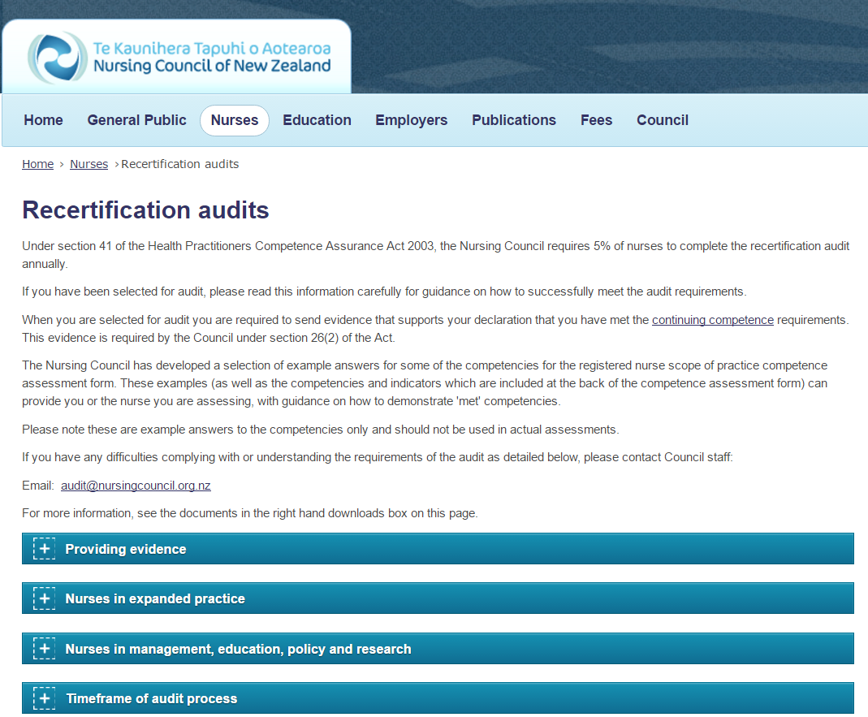
The Nursing Council of New Zealand
Role and resources
The regulatory body for all NZ nurses
Required to monitor competence
Council role
Guides and documents
Is to protect the health and safety of the public by setting standards and ensuring that nurses are competent to practice under the HPCAA (2003)
The Council website holds information to support and guide your practice as well as the continuing competence requirements with useful templates.

Slide 8
HELP !
NCNZ Recertification audit ?
PDRP ?
So what does this all mean? Which one should I be doing?
Read on….

Slide 9

Explaining the terminology
Recertification or PDRP ?… They aren’t the same thing
NCNZ Recertification audit
Under section 41 of the HPCA Act 2003, the NCNZ requires 5% of nurses to complete the recertification audit annually. If selected for audit you are required to send evidence that supports your declaration that you have met the continuing competence requirements (the boxes you tick on your APC declaration…).
This requires 4 pieces of evidence only.
1. Verification of practice hours 2. Verification of professional development hours 3. Self assessment against the competencies 4. Senior nurse or peer assessment against the competencies
PDRP = professional development and recognition programme
PDRPs are developed by employers such as District Health Boards and other big healthcare provider organisations. They require a practice portfolio every 3 years and look at more than competence to practice. They may seek to support individual nurses to develop their practice and also to recognise additional contributions made by nurses to the workplace. PDRP requirements are usually different from the requirements of the recertification audit and have competent, proficient and expert components. Proficient and expert will require more evidence. In some organisations there is remuneration for proficient and expert, linked to the MECA.
The criteria for advancement through these programmes are determined by the provider organisation and not by the Nursing Council. If nurses are on approved PDRP (this means they have a current and assessed portfolio), they are exempted from the recertification audit as described above. If you have access to a PDRP, talk to the PDRP coordinator.
Which do you do…….?
The vast majority of nurses are still in the pool which could be audited by NCNZ (one of the 5%).
If your organisation has access to a PDRP, then you can certainly create a portfolio in that system. Otherwise, it’s the recertification audit, which you may or may not be selected for…..
EITHER IS FINE, but they are not quite the same thing...check the next slide

Slide 10
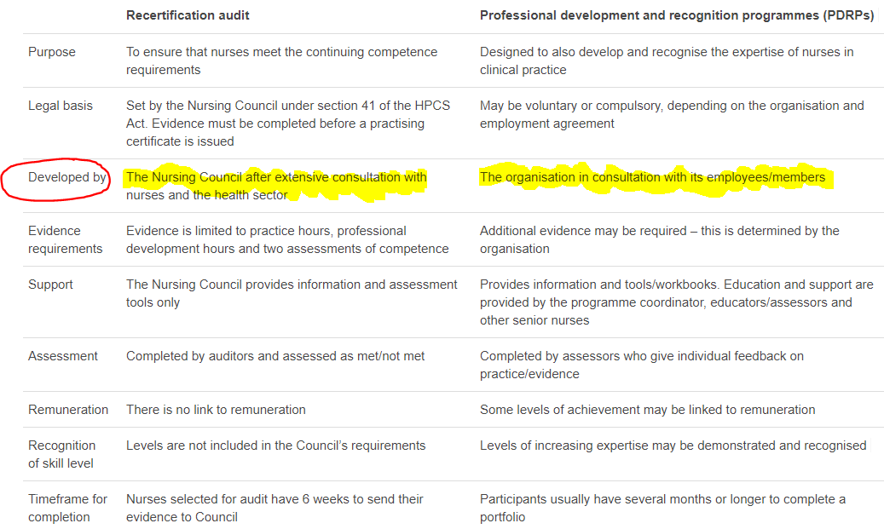
Direct comparison
In this presentation we’ll be looking at recertification audit
Quick check

Slide 11





Methods of presentation
There are two ways to present your recertification audit work to NCNZ
Recommended by the College
Hard copy
Nurseportfolio.nz
A paper based folder.
This is still the most common way to complete a portfolio
An online tailored set of templates
Easy to use, but helps if you are fairly confident in using simple online programmes

Slide 12


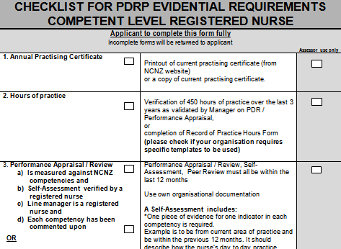
Hard copy portfolio
Basic requirements
Select your A4 folder
Any colour/ design, but keep it to an A4 clip size.
File dividers
You will need between 5 and 10 dividers
Add the relevant checklist.
Check the NCNZ website for the recertification checklist

Slide 13

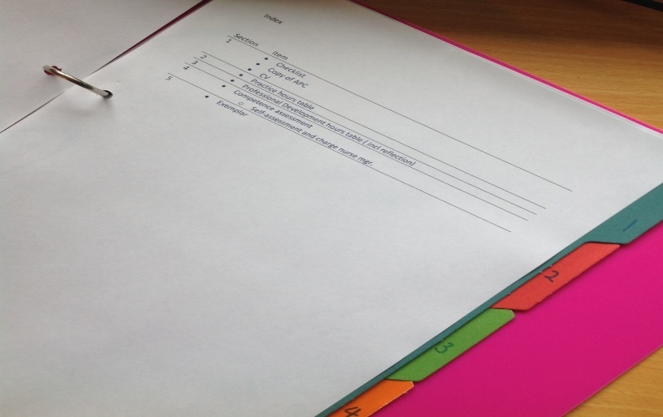
Index
Create a simple index
Refer to the NCNZ checklist and add a simple index
Your index doesn’t need page numbers.
Only include items required in the checklist
List all the contents you will need and use your dividers to make the 4 sections e.g.
Checklist and Annual Practising Certificate
Practice hours
Professional Development hours and reflection
Competence Assessments
A simple index will help you and your portfolio assessor navigate your folder

Slide 14
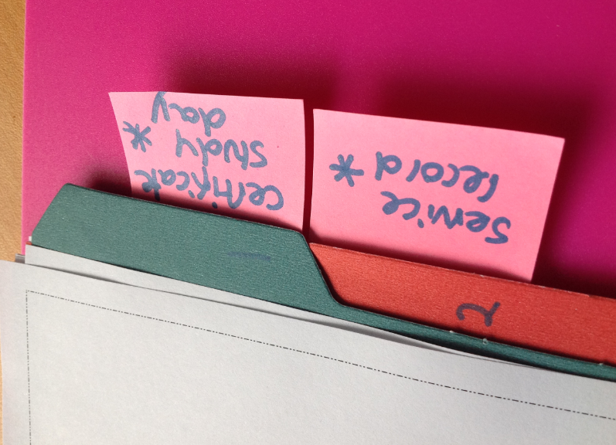
Collecting your evidence
Start with what you already have…
Keep it simple
Remember
Filling a portfolio doesn’t need to be a linear process.
Use ‘post-it’ notes to indicate the items which still need to be added- so you can see where you are up to
Use the templates provided on the NCNZ Recertification audit webpages
Start with what you already have e.g. attendance certificates and build up your evidence from there

Slide 15



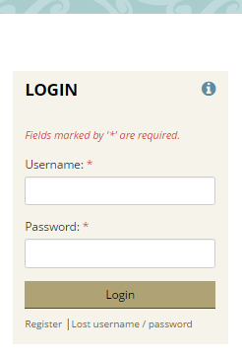


About Nurseportfolio.nz
A new way to present your recertification audit
Access
The College provides free access to the Nurseportfolio.nz platform for all College members through the website
Presentation styles
There are more presentation options e.g. audio links, uploads, feedback directly onto the site pages.
Content
You will present the same evidence as in a hard copy/ folder
Register
Access is via www.nurse.org.nz

Slide 16
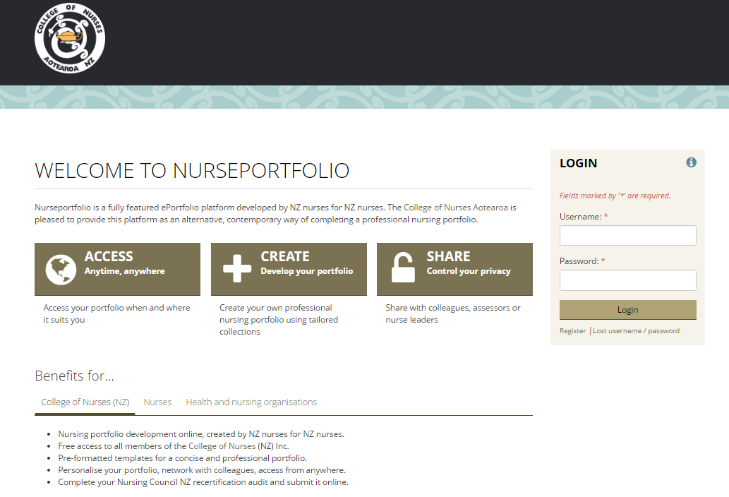
First steps
Nurseportfolio.nz
Front/ dashboard page
The front page shows your activity and provides help for your to start your portfolio.
Use the resources
Use the ‘help’ button to access help guides and FAQs on how to set up your portfolio
Link with Colleagues
Remember the Privacy Act
You can search for colleagues who are also registered on the site.
Tailored system
Select the appropriate competencies for your practice e.g. most will be RN (clinical), ‘copy a collection’ then your portfolio will be populated with the competencies and you can start to personalise.
The College has collections for
RNs in clinical, management, research, policy, education, clinical management
Nurse Practitioners

Slide 17

Share on the site or via secret URL
Share
Share your portfolio
Peers
Your peer review can be done straight onto your portfolio pages, a comment for each competency.
Manager/ nurse leader
Your appraisal and/ or senior nurse assessment can be done on your portfolio pages, a comment for each competency.
Assessor
If your organisation has a PDRP, then you can share your portfolio with the assessor chosen to assess your portfolio
(Please check with PDRP coordinators before you start your ePortfolio)
Nursing Council
For recertification audit, share your completed portfolio with Nursing Council. Make sure you complete the checklist.

Slide 18

For more information…
http://www.nurse.org.nz/
admin@nurse.org.nz

Slide 19
The end
Check out our other professional support presentations
About us
Bullying
Practice issues

