Slide 1

Professional support guides
Presentation

Slide 2

Bullying
Bullying defined
Recognising bullying
Reporting bullying
Managing a bullying situation

Slide 3

Section 1.
General information
This section is about
Defining bullying
Types of bullying and bullies

Slide 4



Defining bullying
What is it?
Workplace bullying
Unreasonable behaviour
Repeated and unreasonable behavior directed towards a worker or group of workers that creates a risk to health and safety e.g. personal attacks, put downs, undermining credibility, performance or confidence.
Actions that a person in the same circumstances would see as unreasonable e.g. victimizing, humiliating, intimidating or threatening.
Repeated
Harassment and discrimination
Behaviour is persistent and can involve a range of actions overtime.
Single incidents are not considered bullying but could escalate so don’t ignore them.
Can be a part of bullying and be perpetrated by groups or individuals towards groups or individuals.
Incidents with work colleagues outside of the work setting are also relevant e.g. at a social function.
Sourced from:
http://www.worksafe.govt.nz/worksafe/information-guidance/all-guidance-items/bullying-guidelines

Slide 5






How it occurs
A variety of ways…
How?
Bullying can occur in a number of ways: email, text, online forums, social media, face to face, ‘behind someone's back’, or with exclusion behaviours.
Outside of work
May occur at work or outside of normal work hours
Single or multiple
Can be directed at a single worker or group and carried out by one person or a group.
Sourced from:
http://www.worksafe.govt.nz/worksafe/information-guidance/all-guidance-items/bullying-guidelines

Slide 6
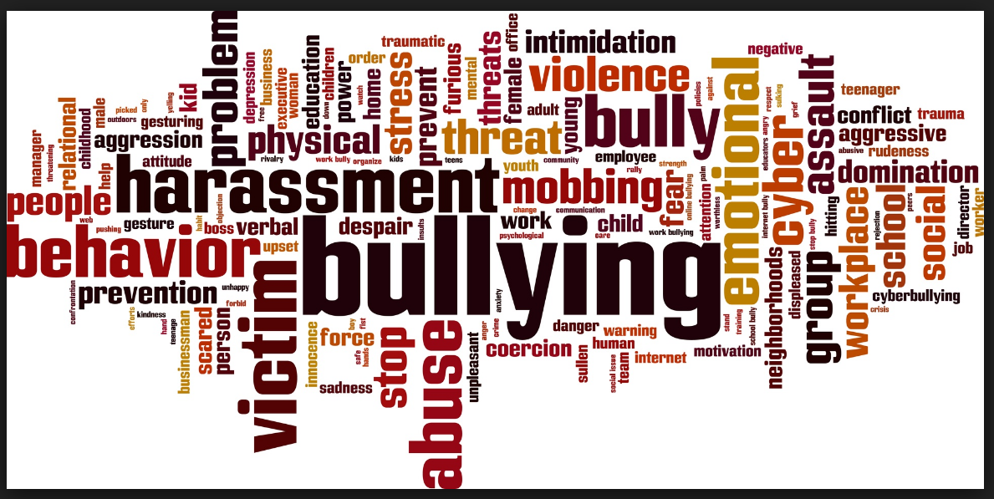


Workplace bullies
Where’s this coming from?
By managers
Deliberate and repeated targeting of employee(s) leaving the employee (s) feeling isolated, powerless and worthless. Can form a pattern and may lead to a string of resignations.
By employees
A notable 15% of all bullying is directed towards managers. Often presents as the withdrawal of cooperation and/ or communication by employee(s).
By colleagues
Unwelcome comments, gestures or comments
Physical, degrading or threatening behavior
Abuse of power, isolation, discrimination
Put downs - ‘sending to Coventry’.
Other possible perpetrators/ victims
Can also be directed at or perpetrated by others such as: clients, patients, students, patient family members and members of the public
Sourced from:
http://www.worksafe.govt.nz/worksafe/information-guidance/all-guidance-items/bullying-guidelines

Slide 7


Types of bully and bullying
More than you think….?
Chronic
Institutional
Learned childhood behavior. Conceptualise themselves as superior and powerful, possibly lacking empathy
Organisational norms, culture and practice allow behavior which causes offence, stress or harm.
Work structures, practices/ policies unreasonably burdensome without concern for wellbeing.
Opportunistic
Situational
Self centered and ambitious, prepared to win at any cost, needing to control everything and everyone. More driven by ambition.
Likely to join a pack when the workplace is going through change or leadership is weak, can use chronic bullies to elevate themselves into importance.
Sourced from:
http://www.worksafe.govt.nz/worksafe/information-guidance/all-guidance-items/bullying-guidelines

Slide 8
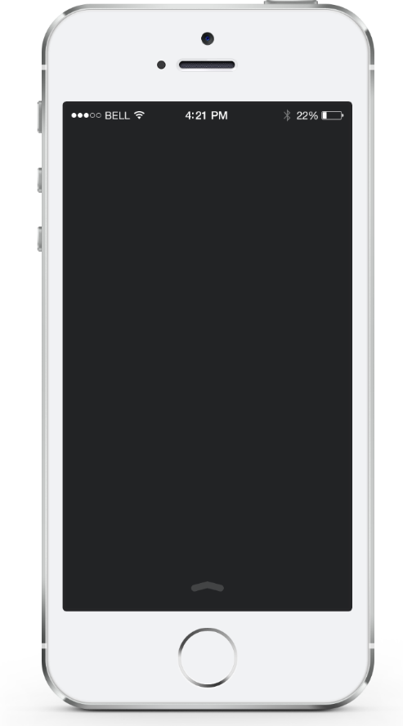


Is it or isn’t it?
These examples are not bullying….
A one off comment
A one off incident
Occasional or one off instances of rudeness, ignoring, tactlessness or forgetfulness
A single incident of unreasonable behaviour (but keep an eye on this incase it escalates)
High performance
Performance management
Setting and expecting high standards for quality and safety
If an employee is not performing or breaches the organisational codes of conduct, policies or procedures.
Feedback
Reasonable instruction
Constructive feedback, advice, assessment and peer review, these are all part of our performance development in nursing.
If a senior nurse or manager requires an employee to carry out their reasonable verbal or written instructions
Sourced from:
http://www.worksafe.govt.nz/worksafe/information-guidance/all-guidance-items/bullying-guidelines

Slide 9

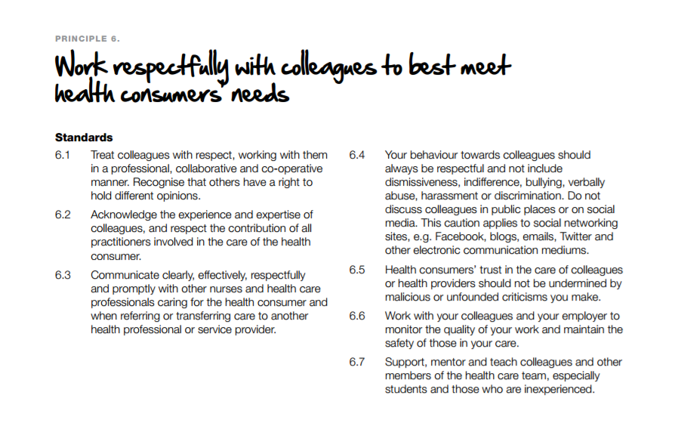
Legislation and codes
To support you
Nursing Council NZ Code of Conduct
Review Principle 6 of the Code this whole section is relevant if the perpetrator is a nurse. A bully would be acting in breach of the Code.
The Employment Relations Act (2000)
If an employer fails to deal adequately with complaints of workplace cullying they could be open to allegations of breaching the Act.
The Human Rights Act (1993)
Remember
Nursing Council
Code of Conduct
Principle 6
This Act is important if there is any form of discrimination.
Health and Safety at Work Act (2015)
Worksafe NZ have extensive information and guidelines to inform and support. This is a vital resource if you think you are being bullied or are managing a bullying situation.
http://www.worksafe.govt.nz/worksafe/information-guidance/all-guidance-items/bullying-guidelines/workplace-bullying

Slide 10

Section 2.
Being bullied?
This section is about
What to do if you are being bullied

Slide 11

So what do you need to do if you are being bullied?
Record, report, don’t support
If you are being bullied and don’t do anything about it , it will get worse.
Once you realise something is wrong, check here to see if its bullying
http://www.worksafe.govt.nz/worksafe/toolshed/bullying-prevention-tools/questionnaire/questionnaire

Slide 12




What to do next….
Don’t’ underestimate the impact
Feeling bullied can affect confidence and create negative emotions. If you feel stressed, anxious and/or depressed get help. Talk to your Doctor and / or a Counsellor.
What do you want the outcome to be?
Whether you have contributed to the situation
Consequences
Look after yourself
Decide how to respond
Follow policy
and procedure
Gather information
Talk to someone you trust.
Find out what your employer’s policy on bullying is. If there isn’t one, follow the Worksafe NZ guidelines.
Document each instance of bullying.
Date, time, place and who was present.
What was said/ done
How you felt
How you responded
What others said and did
Talk to a friend, relative, colleague, safety rep or someone at the College of Nurses.
Let them give you some objective feedback and offer support.
Sourced from:
http://www.worksafe.govt.nz/worksafe/information-guidance/all-guidance-items/bullying-guidelines

Slide 13

Laying a formal complaint
Key actions
Talk to your Manager
Talk to Human Resources
Tell your manager or nurse leader.
If your manager or nurse leader is part of the problem go to the next person up or HR .
If there’s no next manager. Call the College or Worksafe NZ.
This is useful if you have an HR team, especially if you can’t talk to your manager
They can help you follow a correct process.
Lay a complaint
Contact support
You don’t have to wait until things are really bad before you act.
People can’t help if they don’t know.
You can request mediation or if that doesn’t work, it can be escalated to a personal grievance.
You can contact Worksafe NZ on
0800 030 040.
Contact the College on 06 358 6000
Sourced from:
http://www.worksafe.govt.nz/worksafe/information-guidance/all-guidance-items/bullying-guidelines

Slide 14

Section 3.
Sorting out a bullying situation?
This section is about
How to manage a bullying situation

Slide 15

Managing a bullying situation…?
Tips for senior nurses and managers
Treat all matters seriously and act promptly
Use principles of natural justice, use timeframes
Ensure non- victimization, support all parties
Anyone involved should be protected from victimization. Treat all workers with sensitivity, respect and courtesy.
Be neutral, communicate process & outcomes
Be impartial, the lead person should not be directly involved in the incident or have professional/ personal bias. Clear rationale for actions/ non action and timeframes
Maintain confidentiality, document, keep records.
Much more information at : http://www.worksafe.govt.nz/worksafe/information-guidance/all-guidance-items/bullying-guidelines/workplace-bullying
https://www.nurse.org.nz/user/file/1995/Management%20Competencies%20Bullying-%20CoN%20report.pdf
Limit information to only the concerned parties
Include in records interviews, who was present and agreed outcomes. .

Slide 16

For more information…
http://www.nurse.org.nz/
admin@nurse.org.nz

Slide 17
The end
Check out our other professional support presentations
About us
Portfolios
Practice issues

