Slide 1
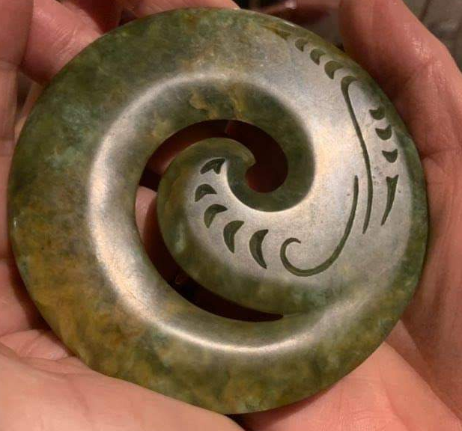

LONGITUDINAL SURVEY 2020
NPNZ

Slide 2



Slide 3

5th consecutive 2nd yearly
Longitudinal Study of practicing NPs in NZ
2012
Start of study
76% NPs [n 76 0f 100] NPs
2014
70% NPs [n91 of 129]
2020
Current study Sept 2020
58% NPs [n275 of 470]

Slide 4
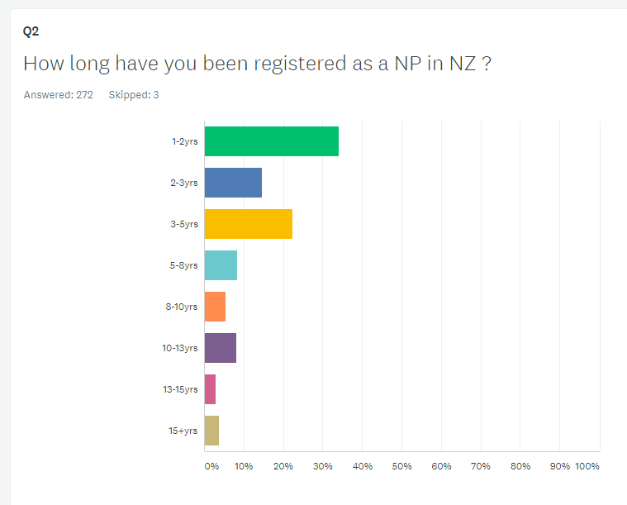
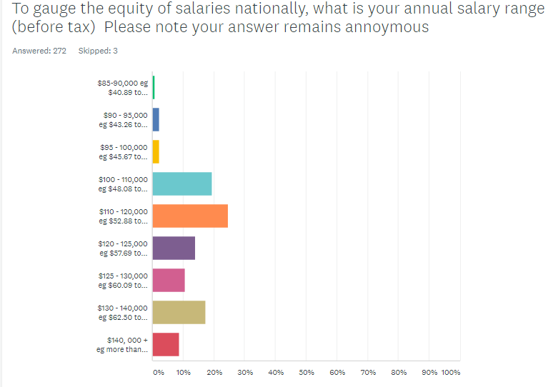

Slide 5
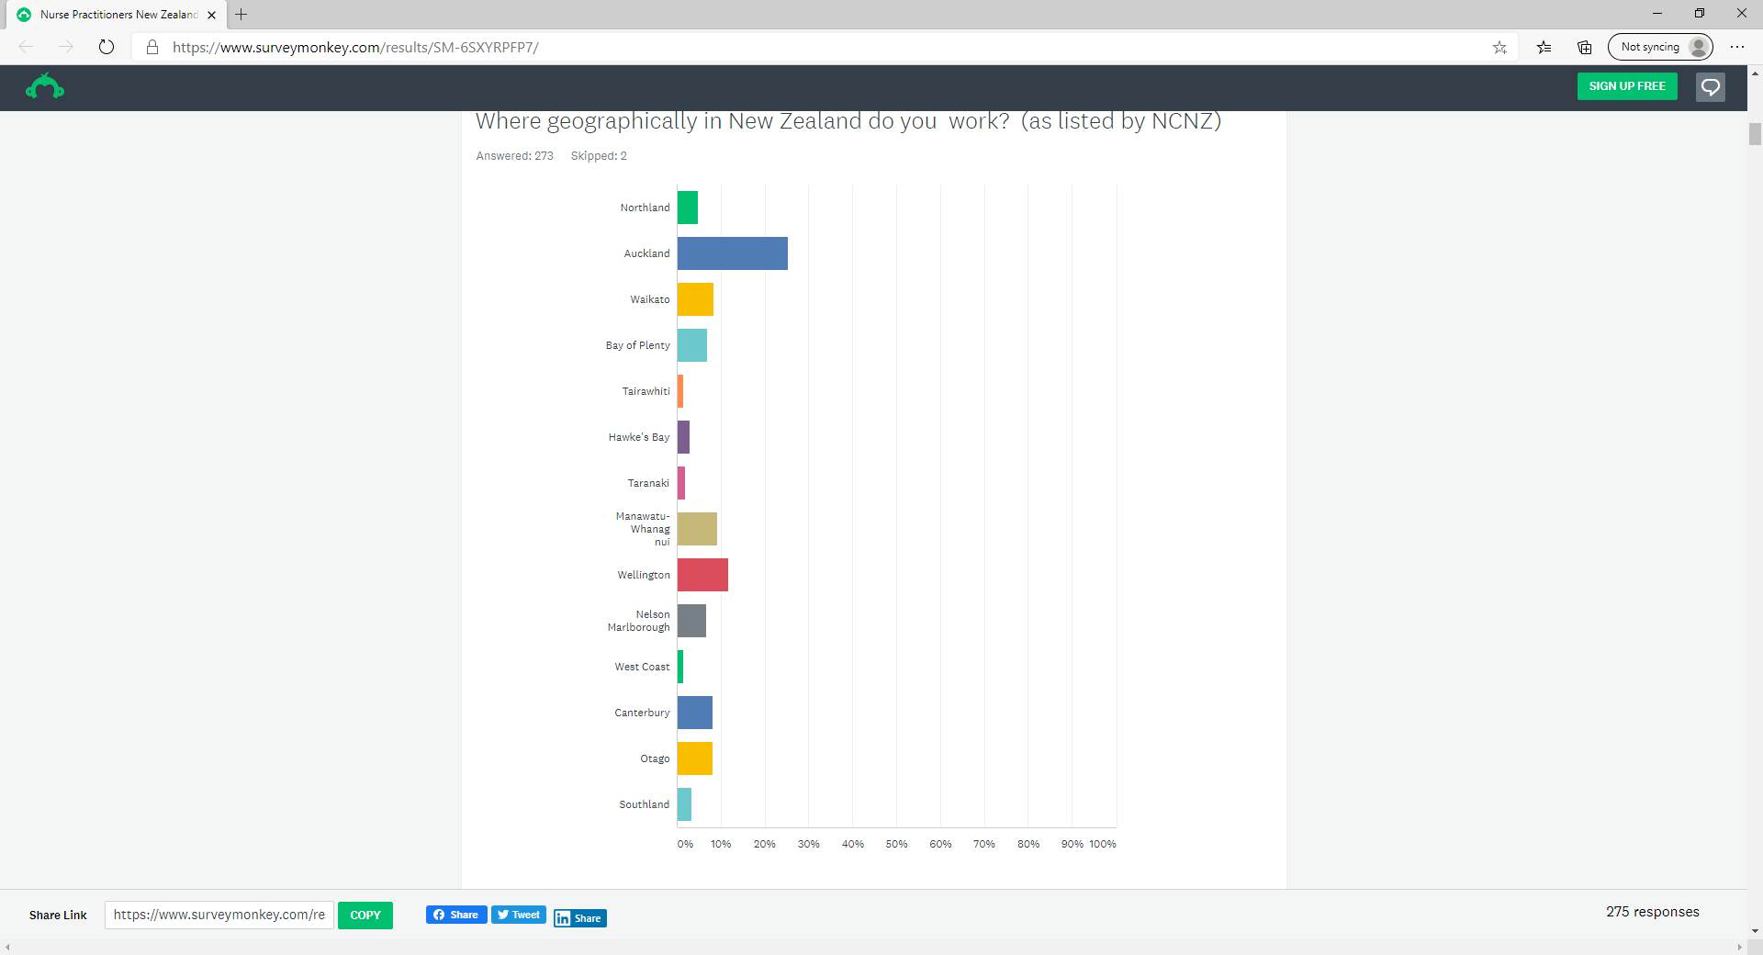
ANSWER CHOICES | RESPONSES
Northland | 4.76% 13
Auckland | 25.27% 69
Waikato | 8.42% 23
Bay of Plenty | 6.96% 19
Tairawhiti | 1.47% 4
Hawke's Bay | 2.93% 8
Taranaki | 1.83% 5
Manawatu-Whanagnui | 9.16% 25
Wellington | 11.72% 32
Nelson Marlborough | 6.59% 18
West Coast | 1.47% 4
Canterbury | 8.06% 22
Otago | 8.06% 22
Southland | 3.30% 9
TOTAL | 273

Slide 6
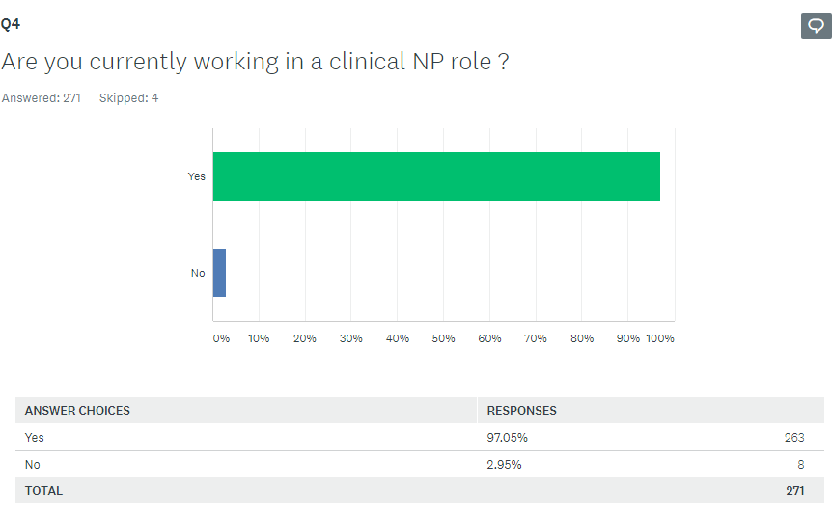
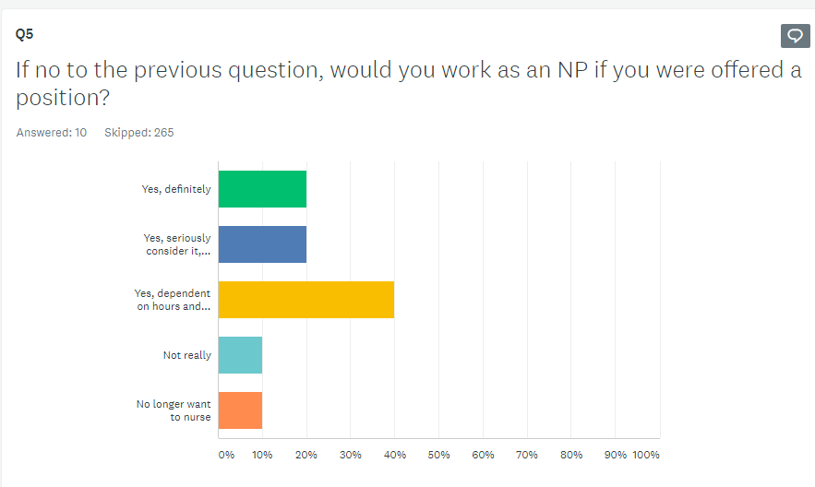
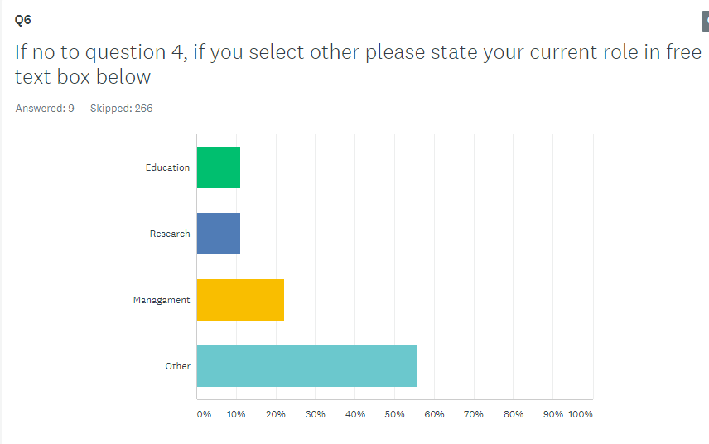
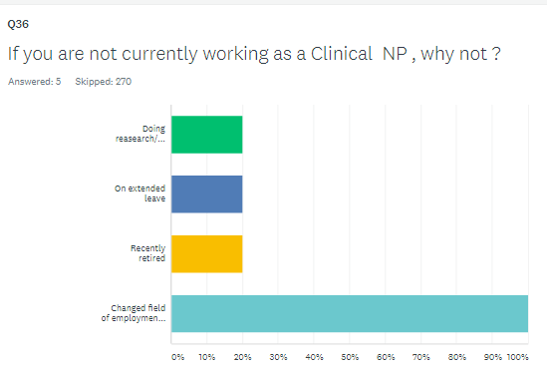

Slide 7
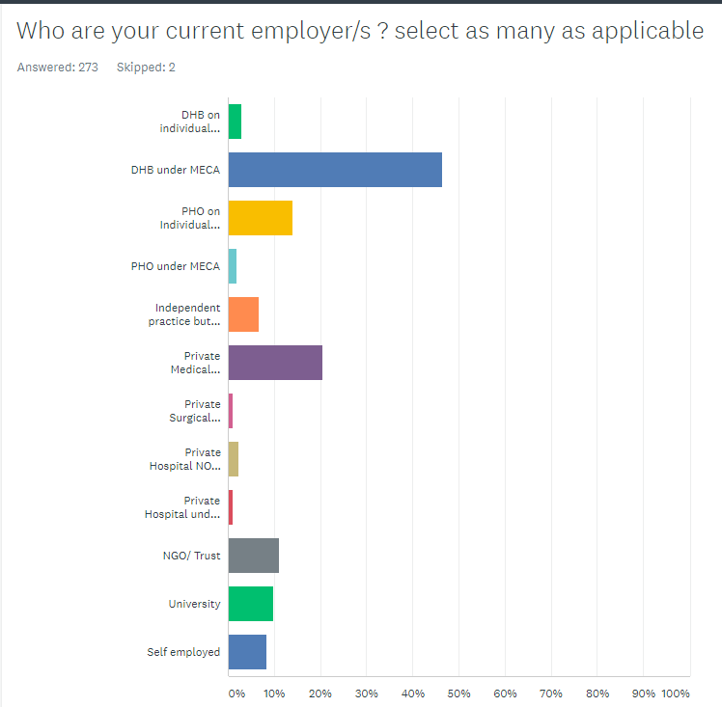
ANSWER CHOICES | RESPONSES
DHB on individual contract NON MECA | 2.93% 8
DHB under MECA | 46.52% 127
PHO on Individual contract NON MECA | 13.92% 38
PHO under MECA | 1.83% 5
Independent practice but not self employed | 6.59% 18
Private Medical Practice | 20.51% 56
Private Surgical Practice | 1.10% 3
Private Hospital NON MECA | 2.20% 6
Private Hospital under MECA | 1.10% 3
NGO/ Trust | 10.99% 30
University | 9.89% 27
Self employed | 8.42% 23
Total Respondents: 273

Slide 8
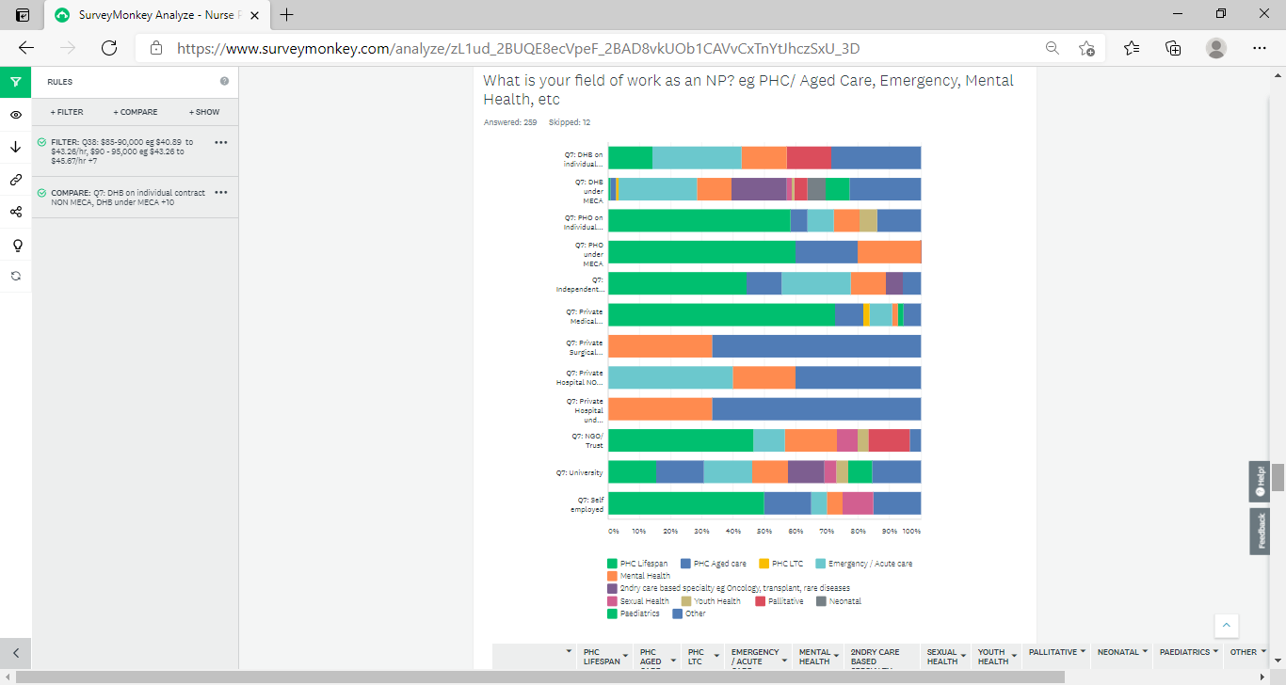
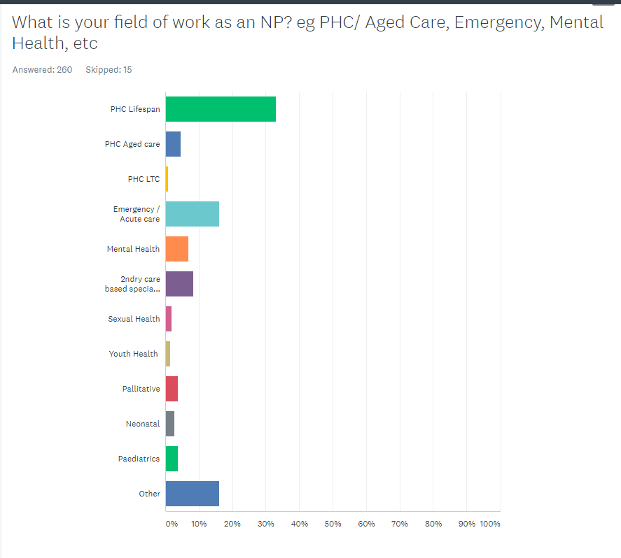

Slide 9
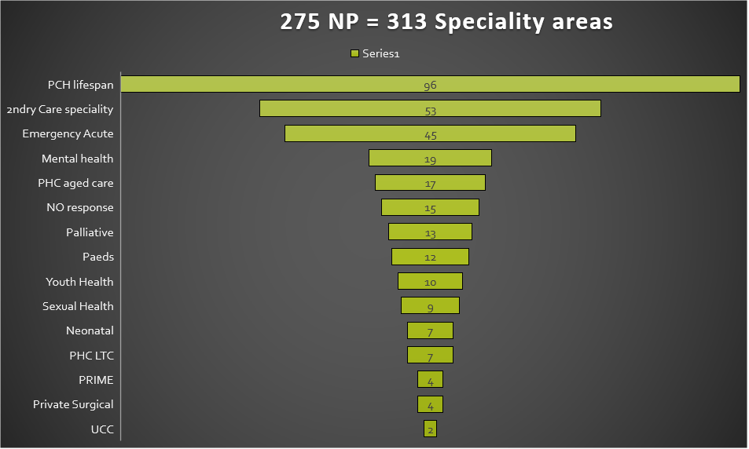

Slide 10
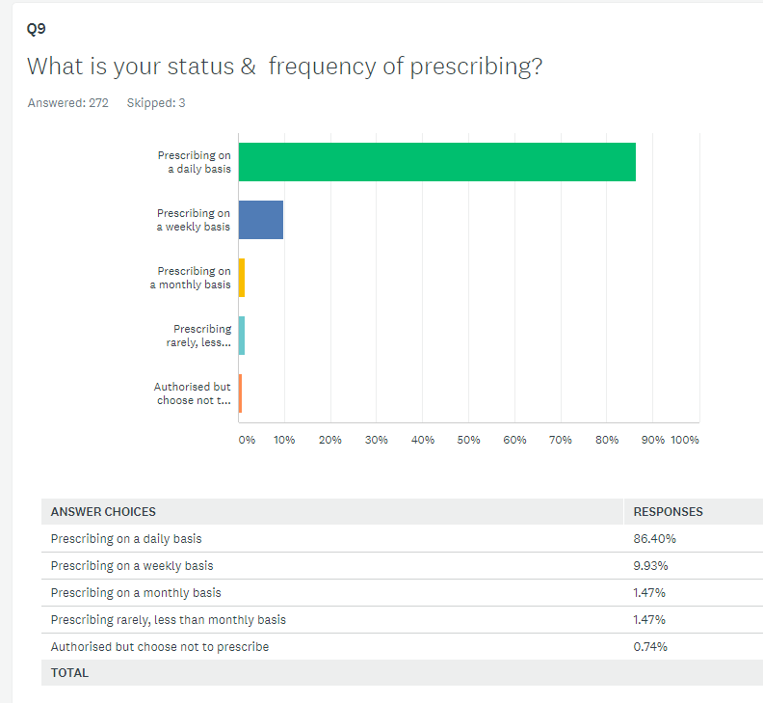
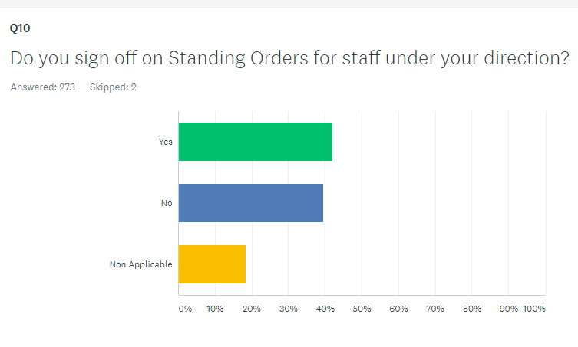

Slide 11
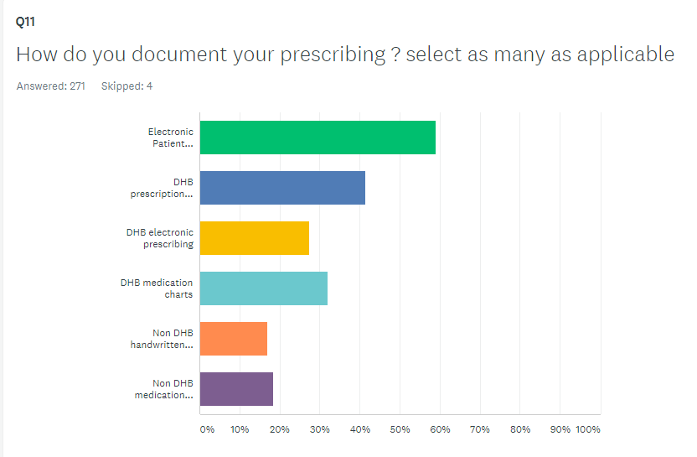
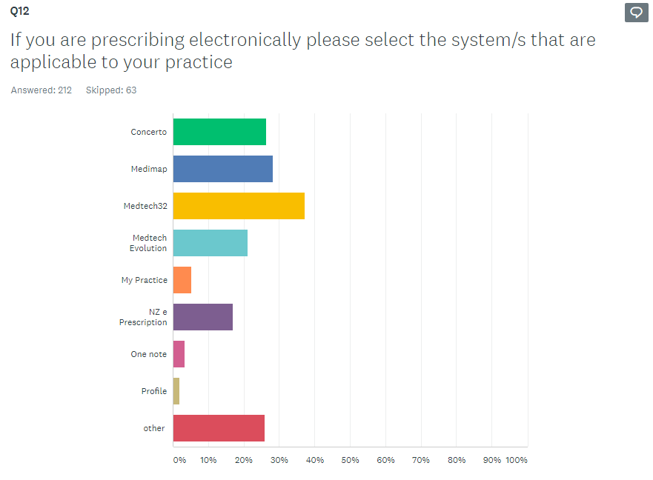

Slide 12
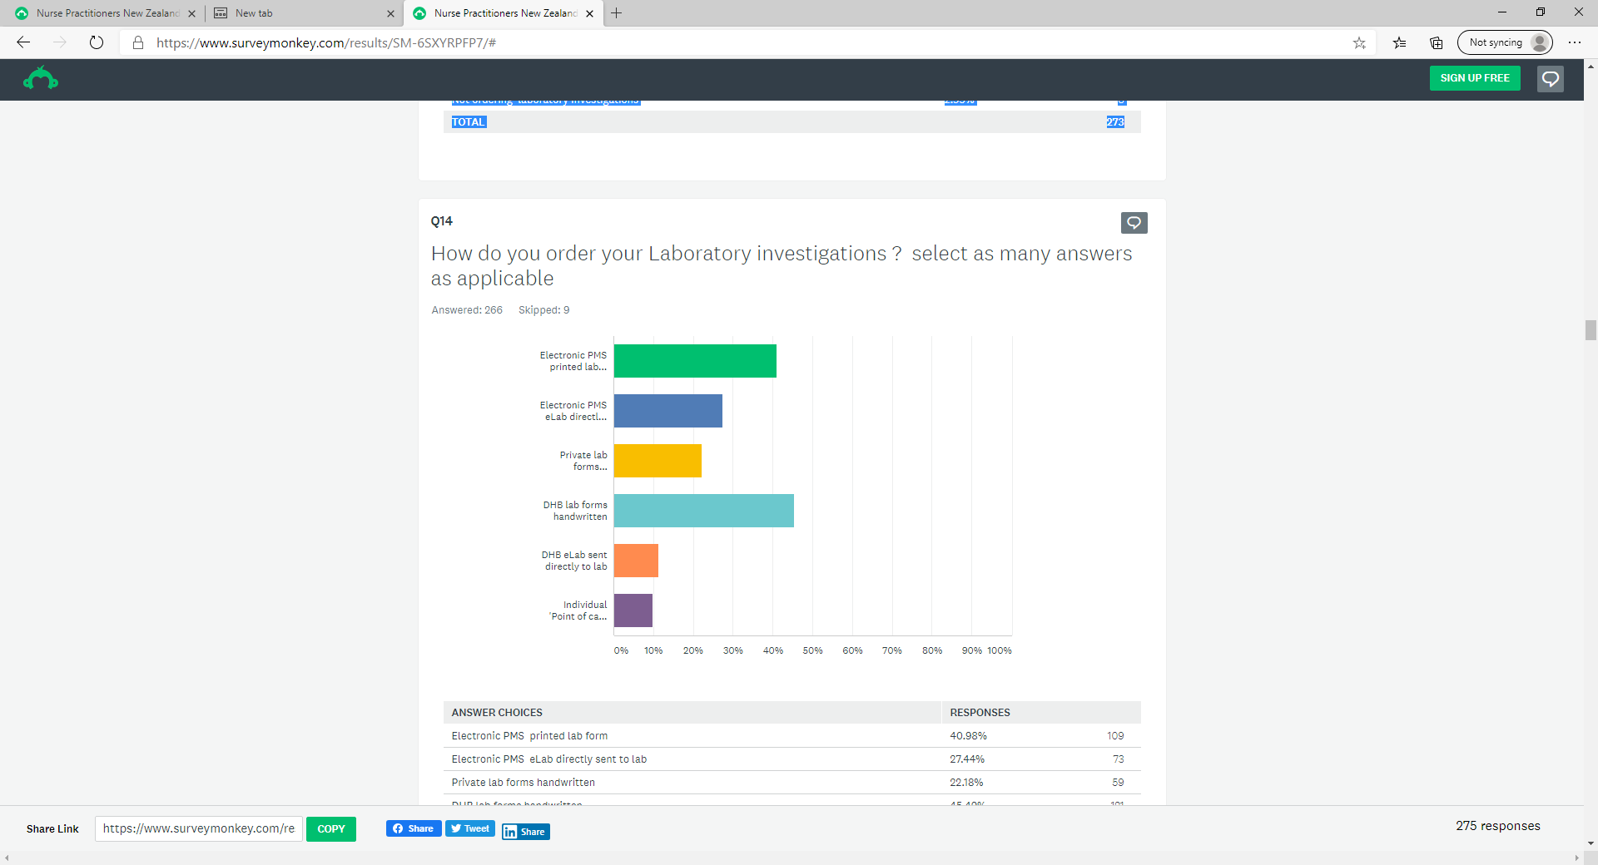
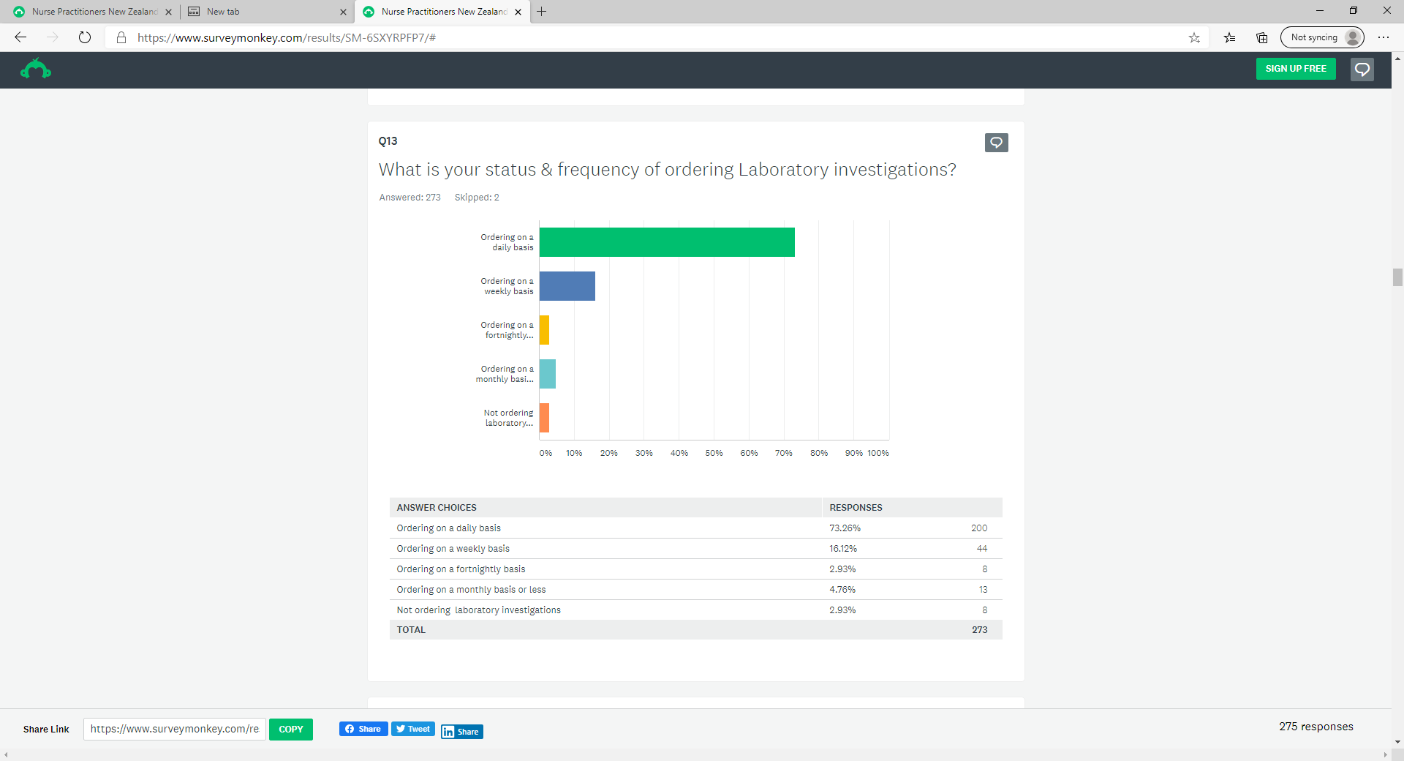
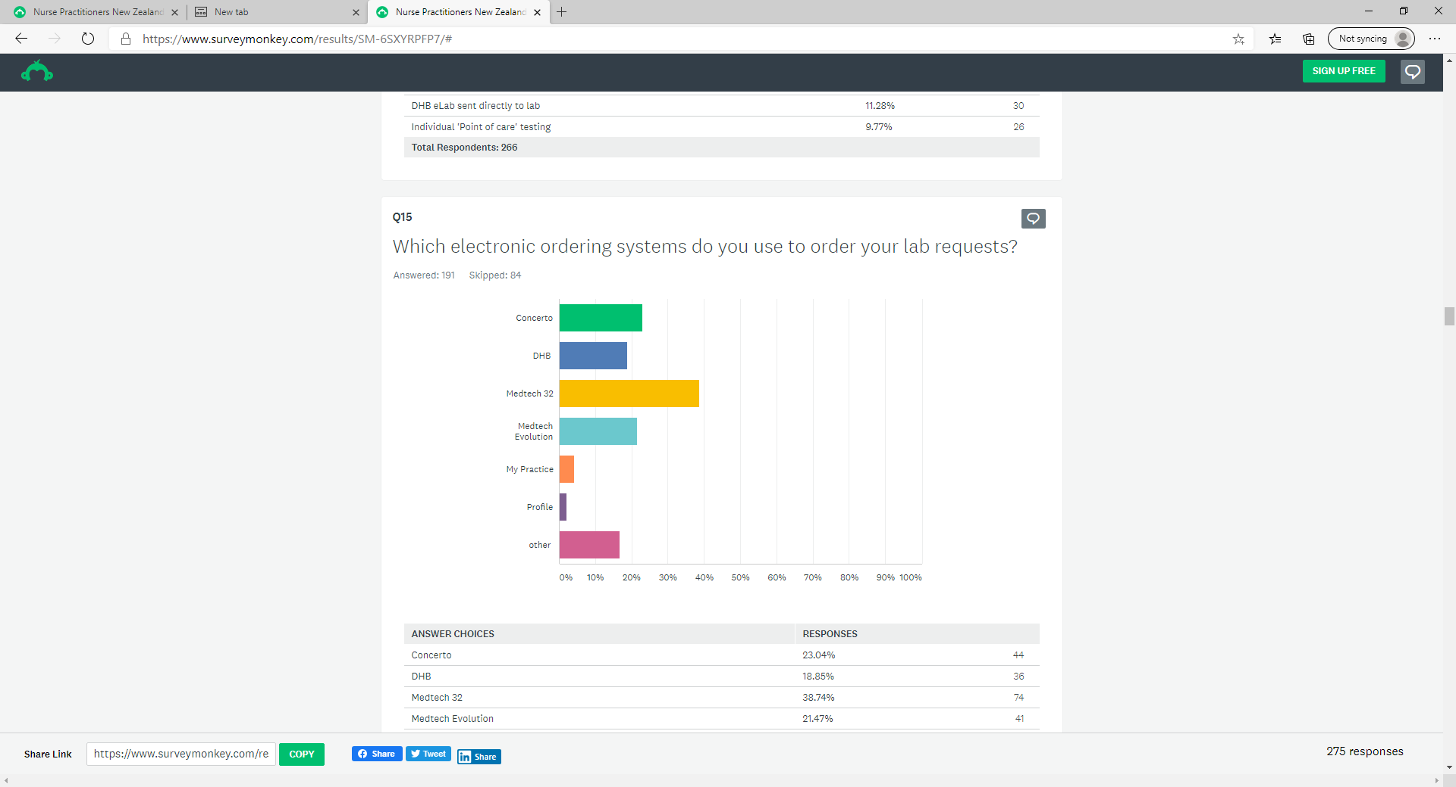

Slide 13
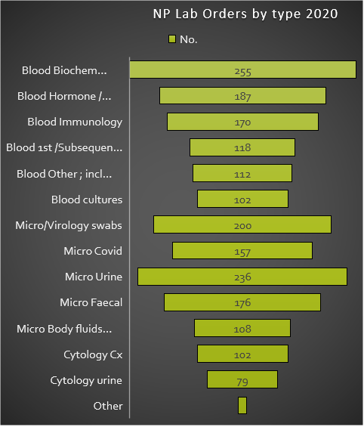
‘Other’ Laboratory testing very specific fields;
Tumour markers - Ca 15-3, Ca19-9, ca12-5, Chromogrannin A, urinary 5HIAA, alpha fetoprotein, beta HCG, endocrine studies, molecular markers on histology tissue
Insulin autoantibodies & c-peptide, serum insulin,
urine toxicology
Cytology other fluids eg ascites, pleural fluid
Group and Holds /Cross match/Blood products
sweat tests, alpha one antitrypsin
RAST
Specialist testing speciation and sensitivities
‘Delirium Screen’ rule out for Mental Health field

Slide 14
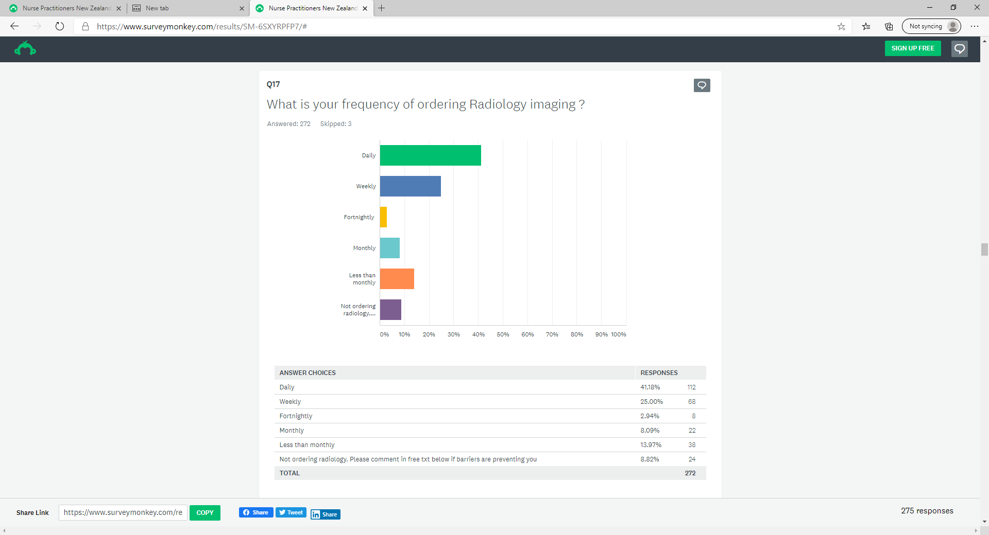
Why NPs are not ordering imaging?
One NP unable to as non DHB employee, one other Southland NP stated unable to order CT head
Others requested access to TOP/Pregnancy US be widened up.
15x clinical NPs do not order Imaging, no concerns or comments
X6 NPs do not order imaging as work team generate requests
x3 NPs state imaging not included in their current roles.

Slide 15
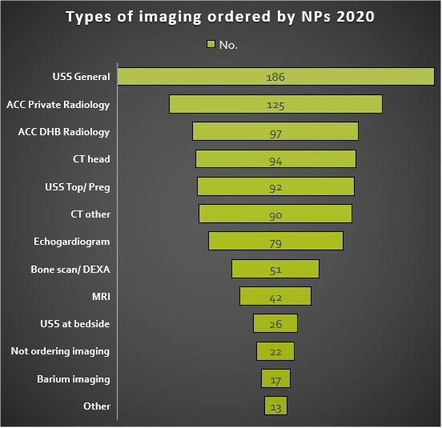
‘Other’ imaging requested by NPs;
USS; Fibroscans [2]; NIVS - Duplex venous and arterial scans [1]; Shearwave [1];Crainial [1];
Xray; DEXA bone scan [2], full baby Xray [1]
CT/ Nuclear; PET[1]; Gastric Emptying Scan [1]; MUGA angiogram [1], Myocardial Perfusion scan [1], CTA angiogram[1]
Imaging Issues with locality ‘work arounds’:
One NP [Manwatu-Whanagnui] has to get GP to sign off TOP USS, Bone scan, & CT head.
Three NPs [Waikato [1], & Bay of Plenty[2]] are ordering TOP scans with GP cover signing.
One NP [Wellington] orders CT head with physician sign off.
One NP [Wellington] orders CT head & USS TOP with physician sign off.

Slide 16
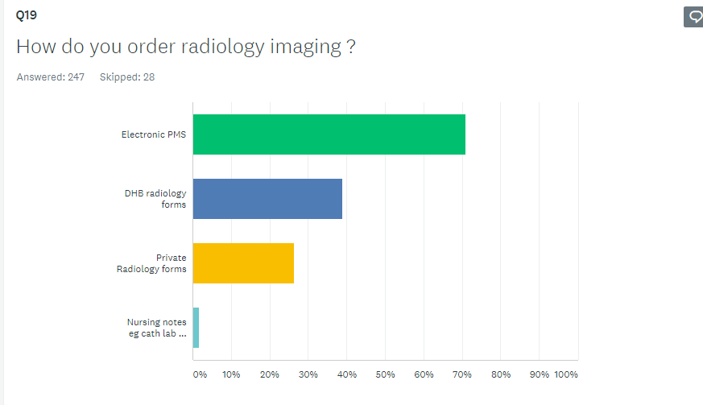
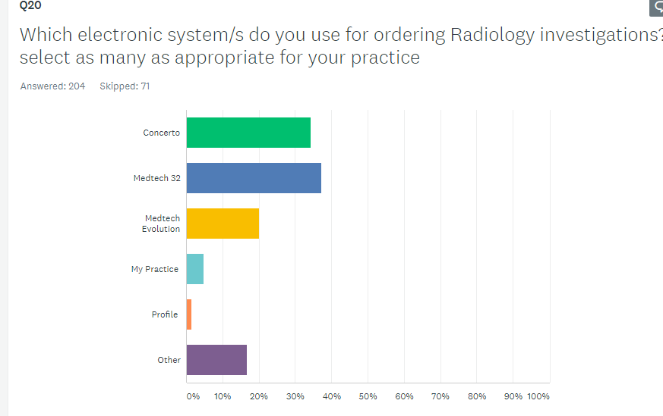

Slide 17
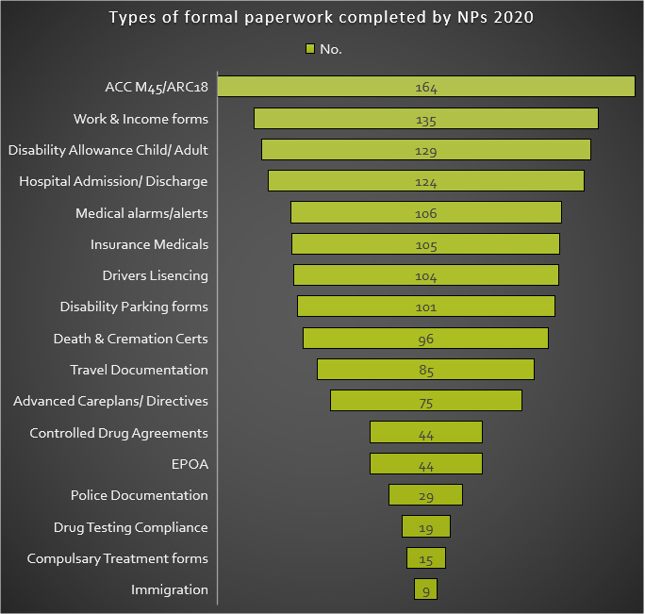
0ther speciality specific:
Counselling,
Court /legal letters,
MOEd high needs funding applications ,
Sections [10/11] of MHA,
Special dispensation for Covid,
Capacity certificates [4&5]
NP report for guardianship,
Advocacy letters.

Slide 18
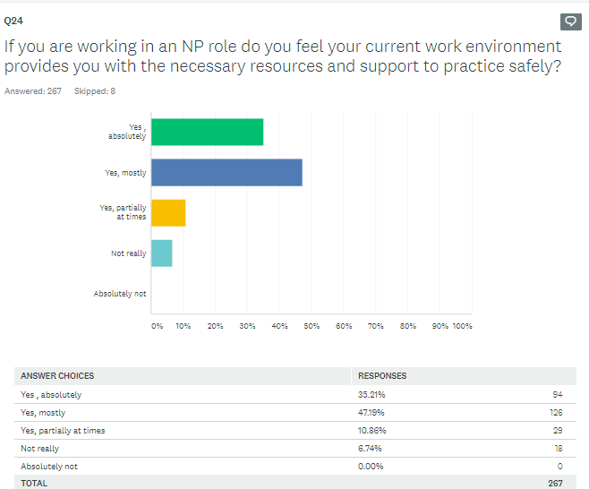
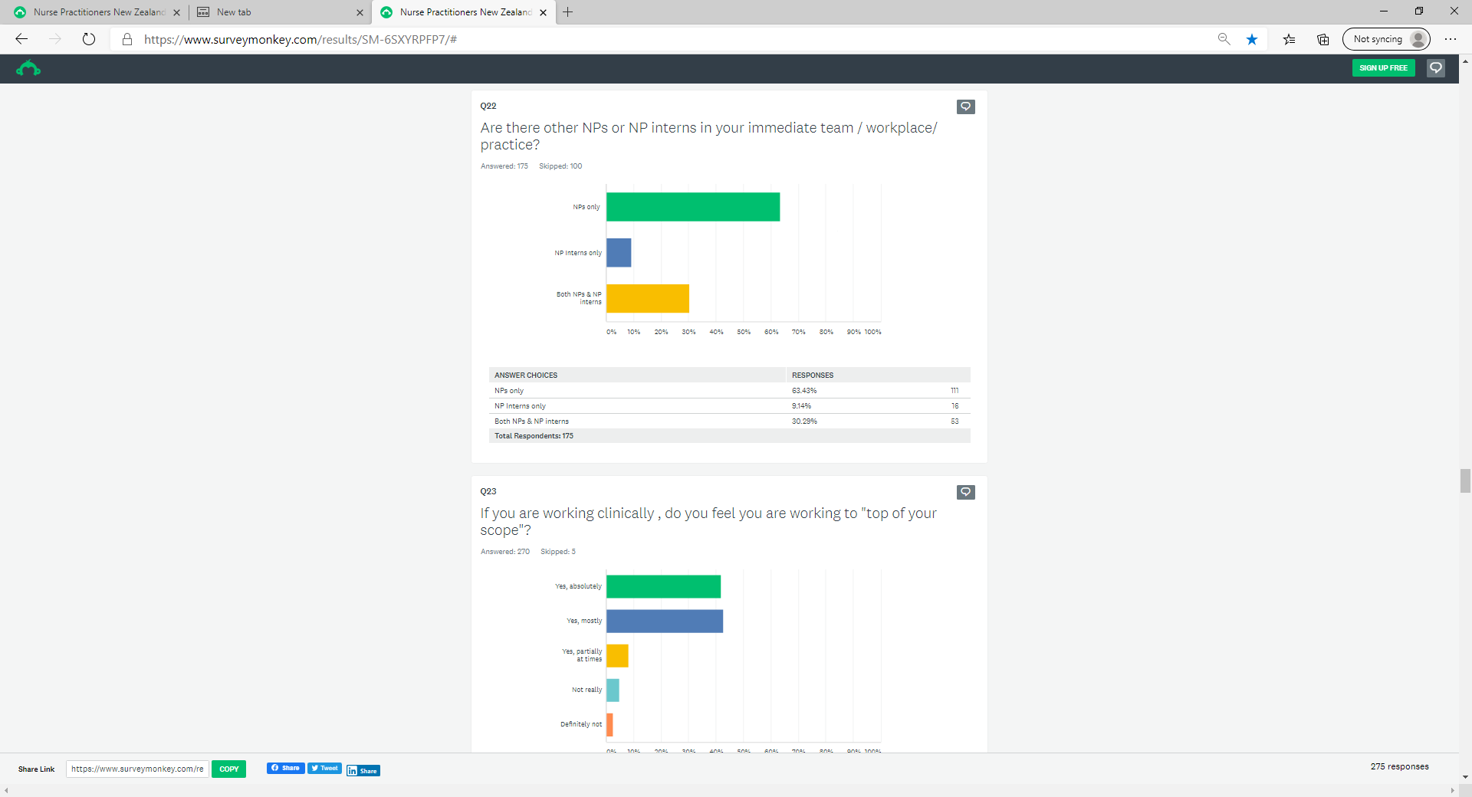

Slide 19
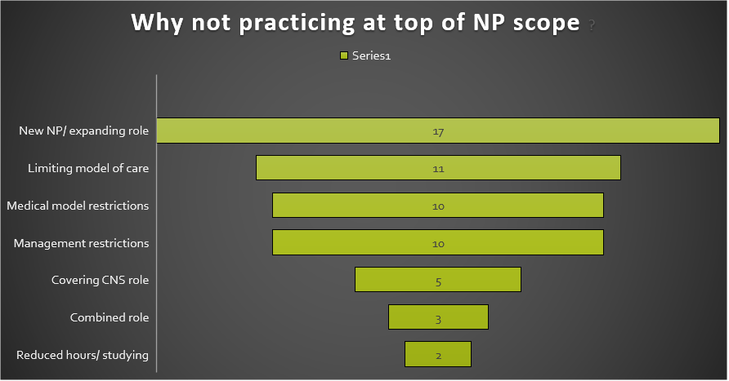

Slide 20
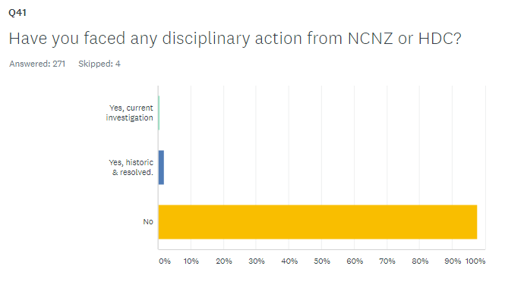
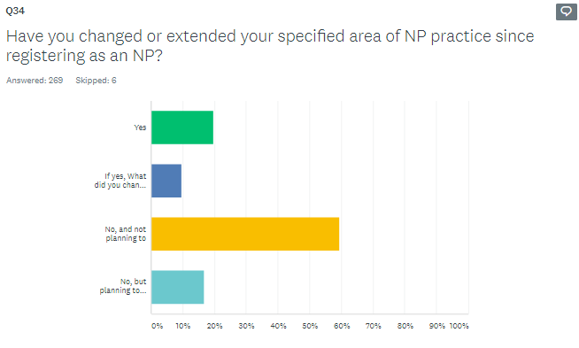
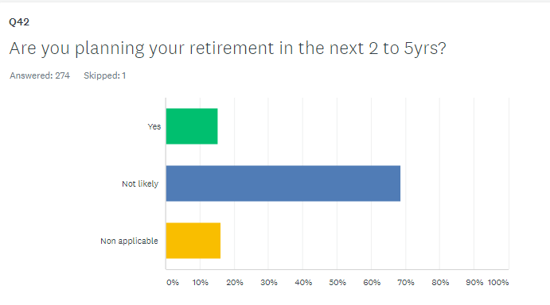

Slide 21
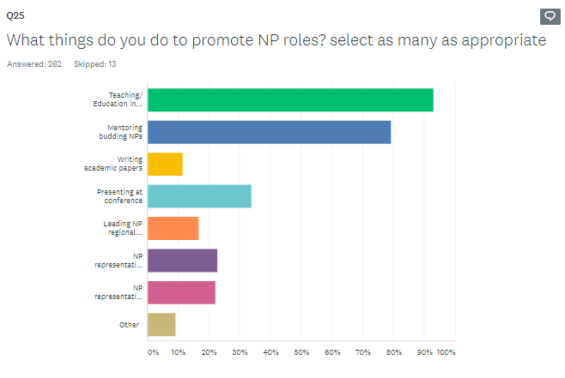
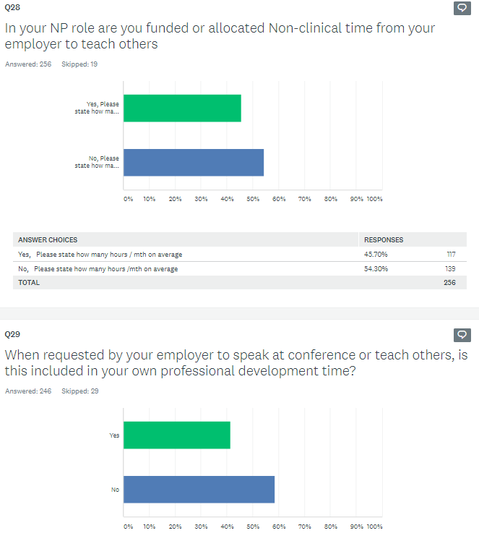
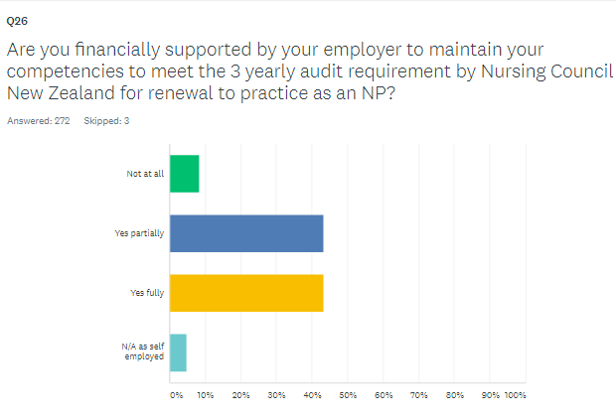

Slide 22
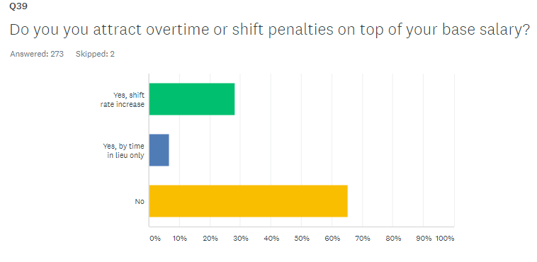
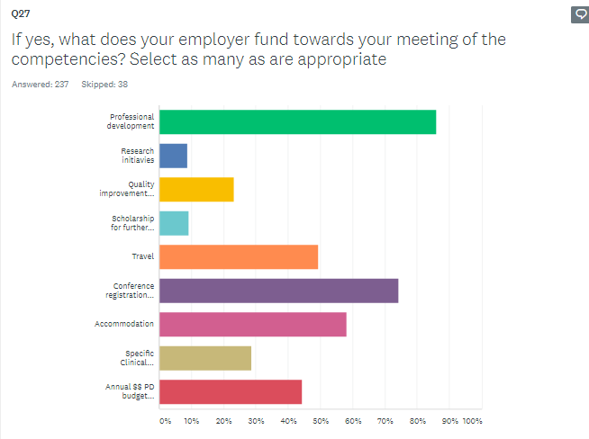

Slide 23
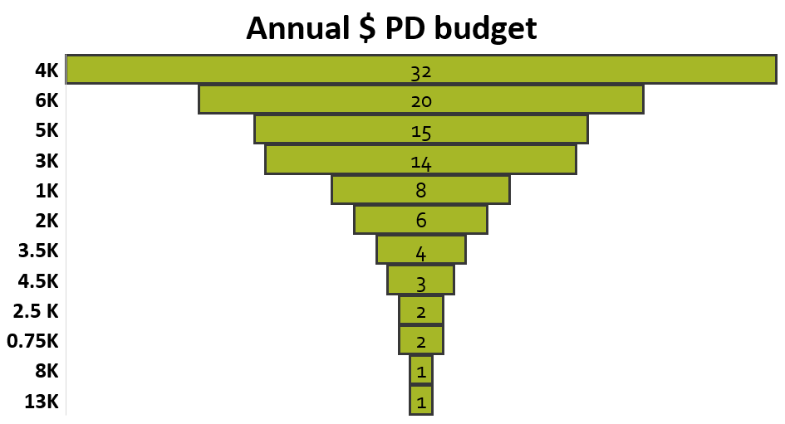

Slide 24
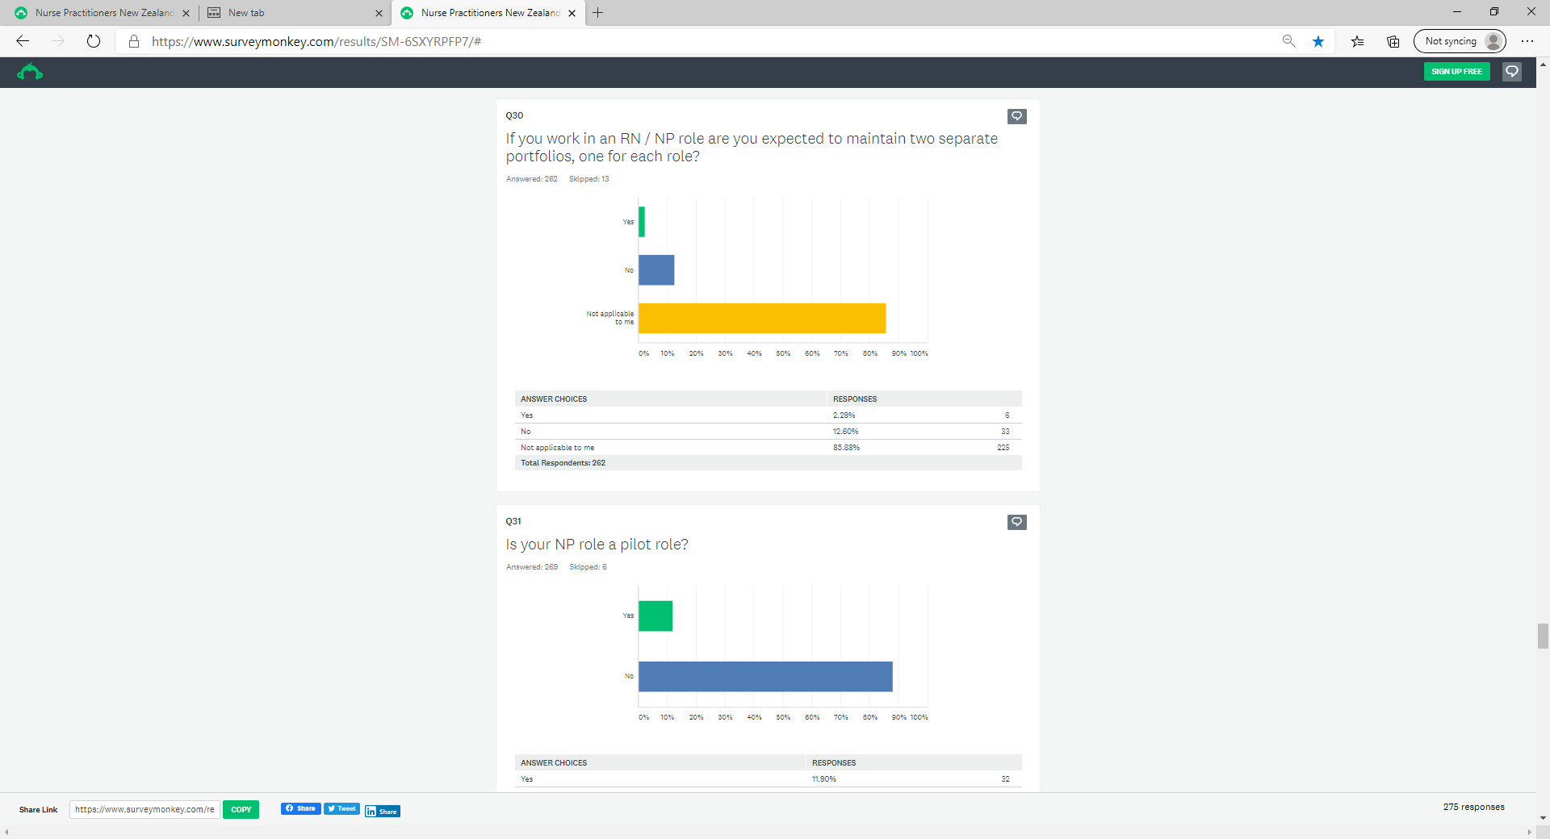
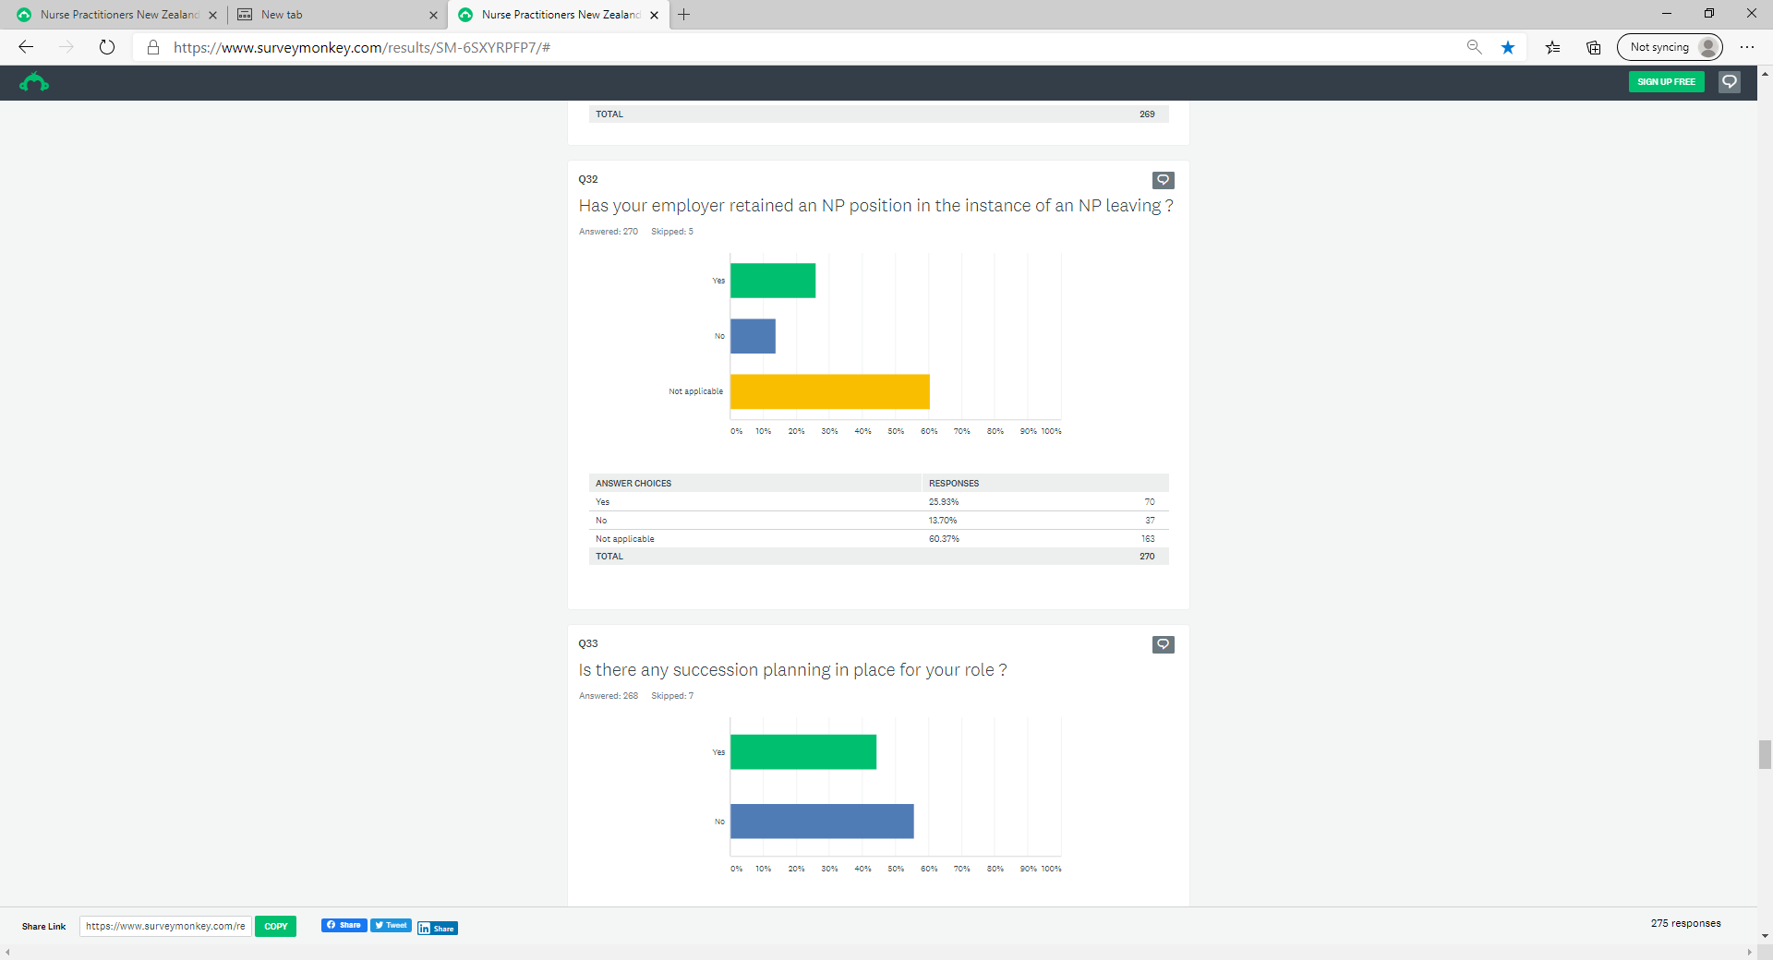

Slide 25
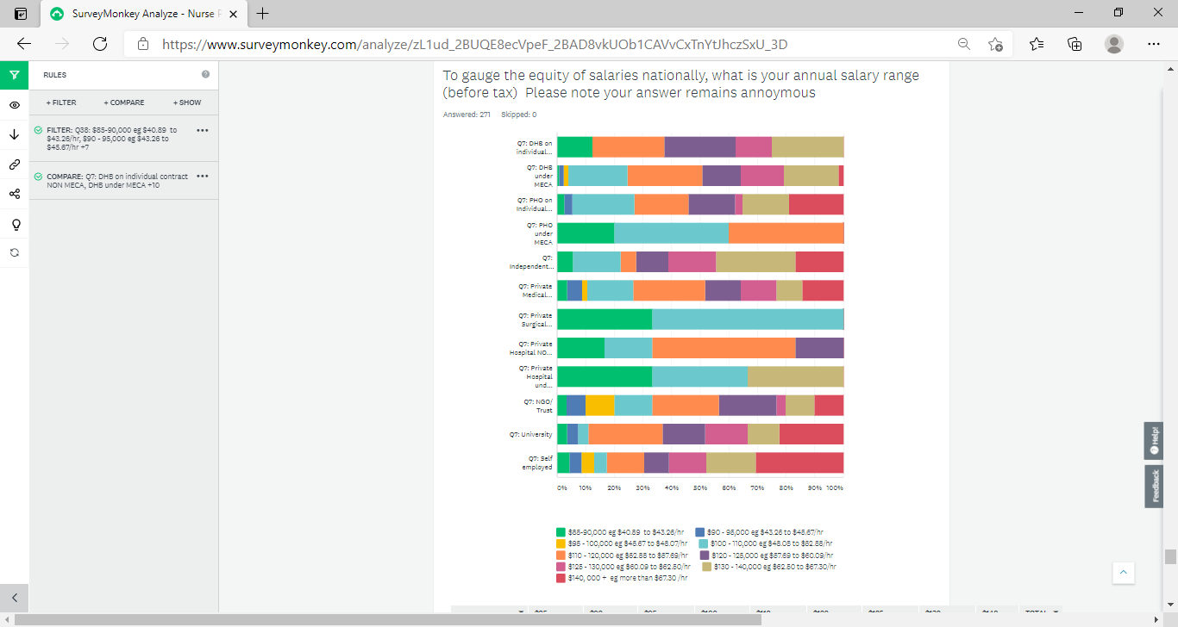
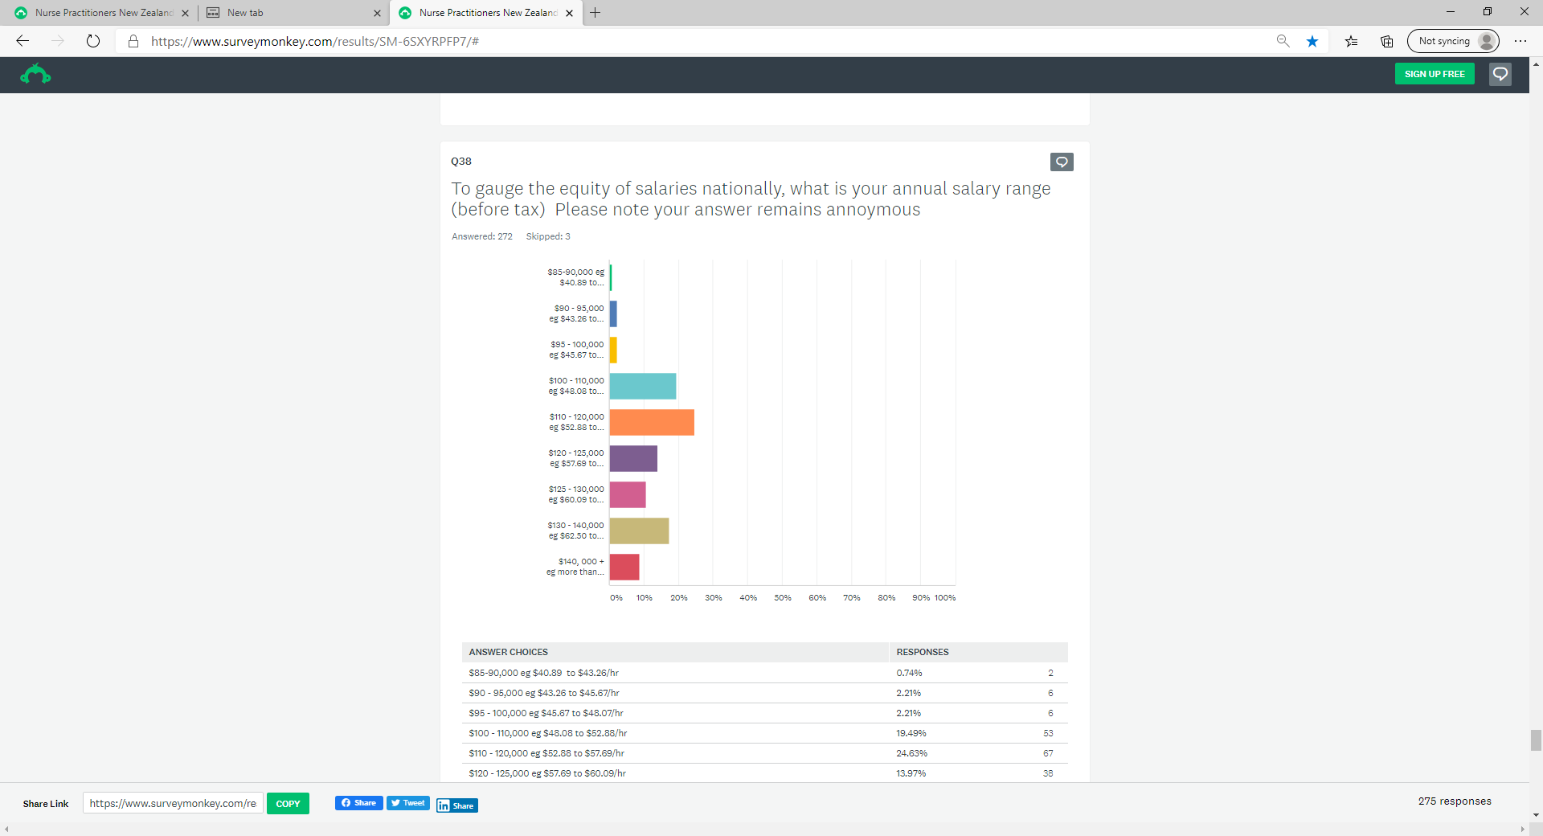

Slide 26
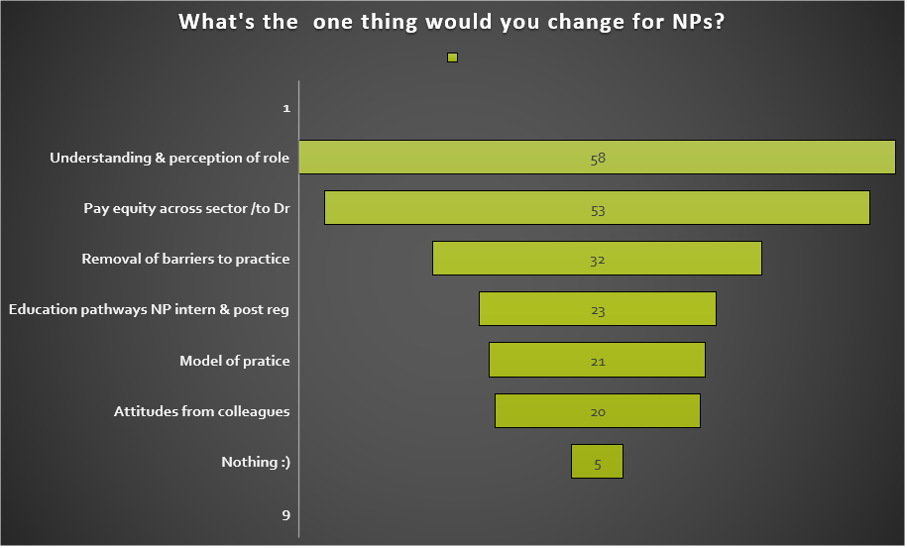

Slide 27
5 themes
3. Mixed Barriers to practice [n.31]
Mix of local and national clinical barriers.
4. Education pathways [23]
Requests for specific and targeted NP education pathways for both pre and post registration as an NP.
5. Model of practice [n.21]
to be able to practice an ‘NP model of care’ flexibility, not constrained by a medical model, funding pools and management
1.Understanding of scope and capabilities [n.58]
Strongest concern, there is poor perception or lack of understanding by the public of NP scope and capabilities
2. Pay scale equity across sector and inline to medicine [n.53]
Call for Pay equity of NP base rates across the whole of health sector

Slide 28
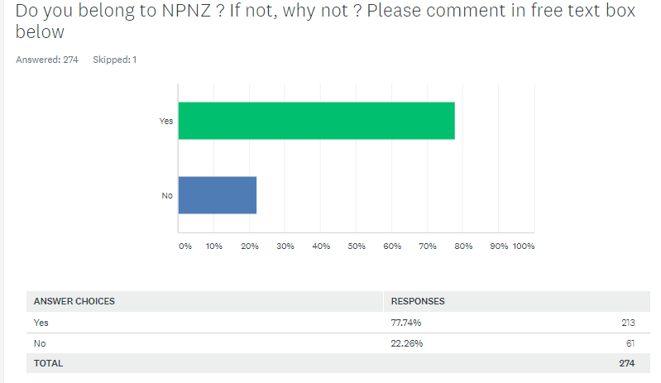
Lastly … THANK YOU
for participating

